Slide 1
Experiments with non-temporal writes and application architectures
Joe Damato

Slide 2
Hi, my name is Joe.
I work at Fastly.
My opinions are my own.

Slide 3
I am not an x86 expert.
But I do know a little bit.

Slide 4
Before we can talk about networking, we need to talk about CPU caches.

Slide 5
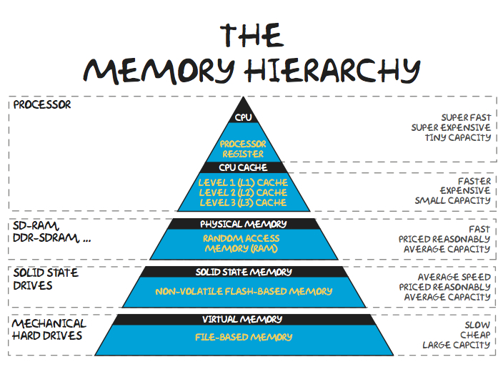

Slide 6
lstopo --of png > blah.png

Slide 7
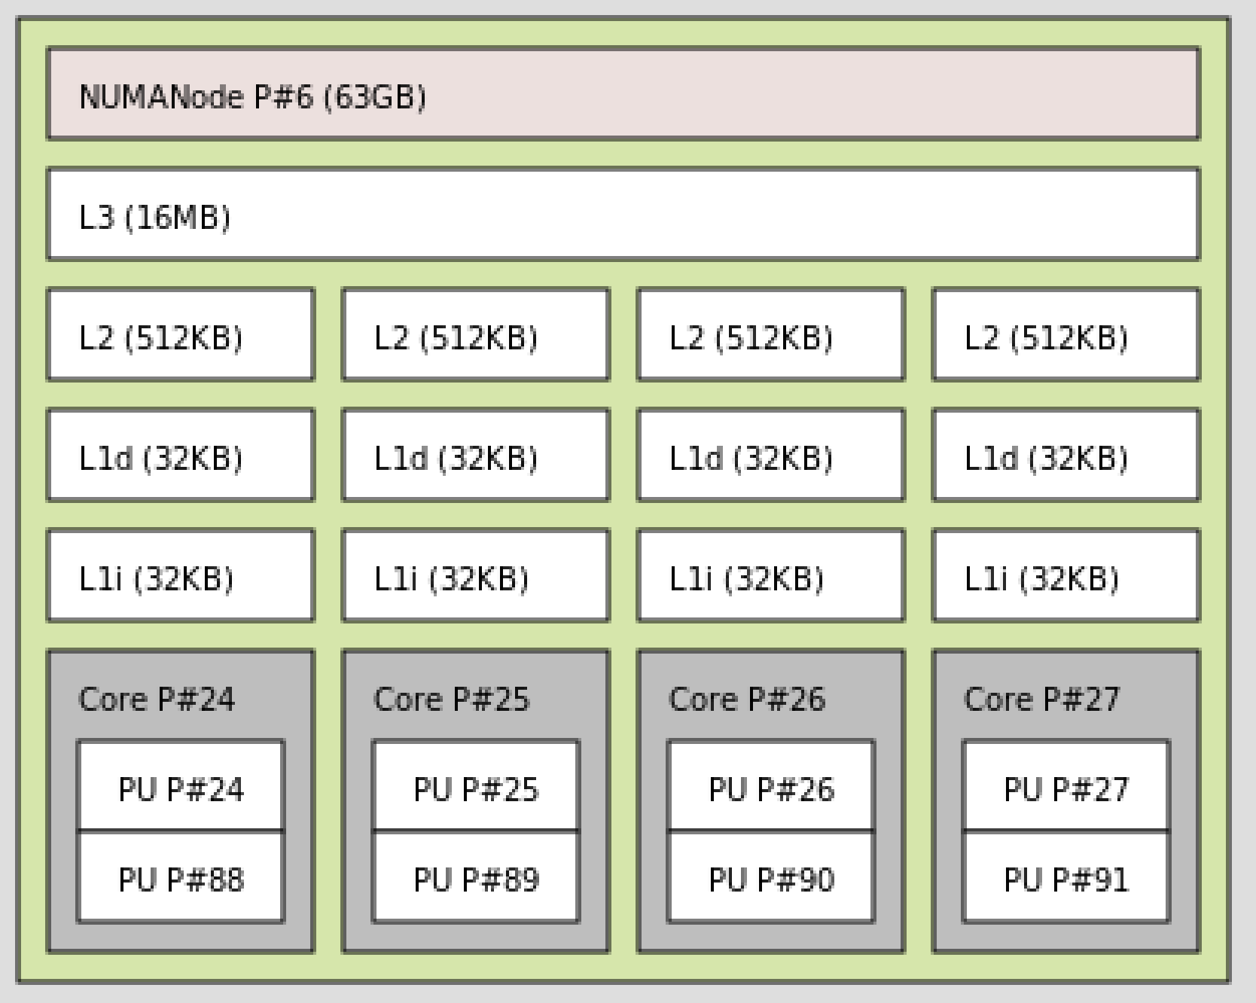
A Zen2 “Core Complex” (CCX)

Slide 8
Two important properties of data access patterns to remember to maximize the benefit of CPU cache

Slide 9
Spatial locality
Temporal locality

Slide 10
Classic example:
2-D array access in C
Row major vs column major

Slide 11
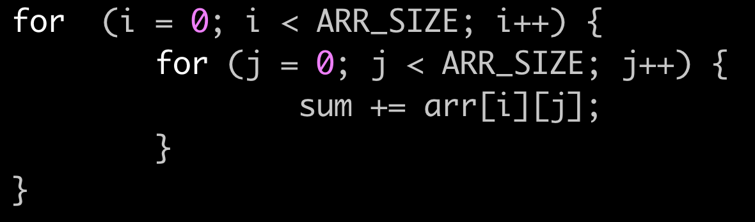
Row major order

Slide 12
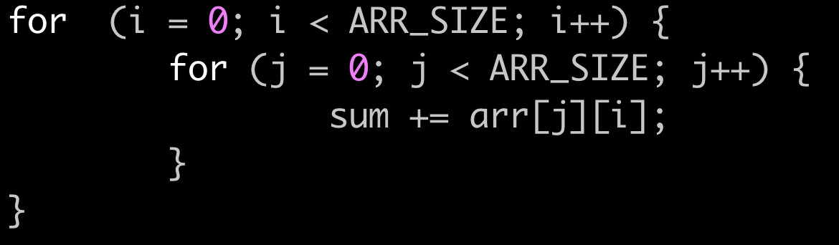
Column major order

Slide 13
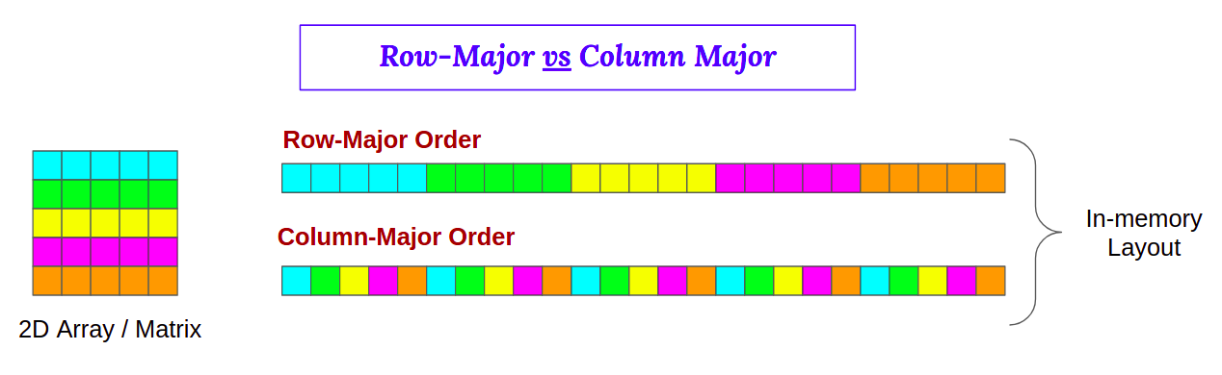
Each color change is a cache miss

Slide 14
Benchmarks
Tinymembench - lots of memory related benchmarks

Slide 15
Running a microbenchmark

Slide 16
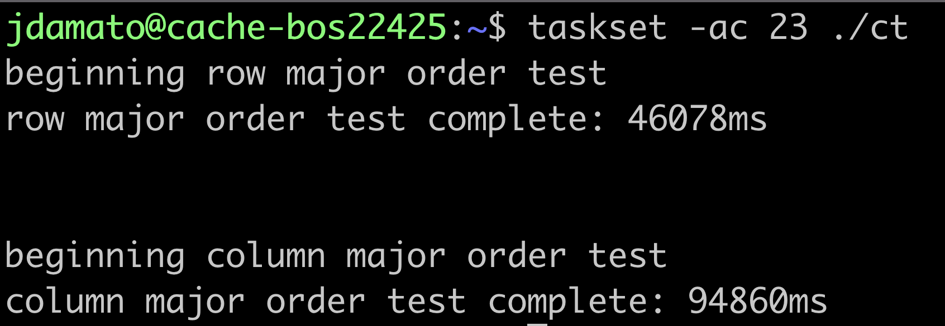
Result

Slide 17
Result
Row major access is >2x faster
Because data accesses have:
Spatial locality (accessing nearby data)
Temporal locality (accessing data again soon)

Slide 18
But: what if we know we don’t need temporal locality?

Slide 19
The CPU cache is thrashed unnecessarily.
Useful data is evicted from the cache in exchange for data where there’s no locality benefit.

Slide 20
It’d be nice to avoid the CPU cache evicting in-use data in exchange for data we know we won’t touch again

Slide 21
Using “non-temporal” stores we can write data directly to RAM without disturbing the CPU cache.

Slide 22


Slide 23
OK.
What does this have to do with networking?

Slide 25
ethtool allows you to enable “no cache copy” from userspace on transmit

Slide 26
What does that mean?

Slide 27
Diagram of tx-nocache-copy off

Slide 28
CPU cache
Data in cache
Regular copy
Transmit
NIC
Kernel buffer
User app
CPU

Slide 29
Diagram of tx-nocache-copy on

Slide 30
CPU cache
Data in cache
no-cache-copy
Transmit
NIC
Kernel buffer
User app
CPU

Slide 31
With tx-nocache-copy enabled and assuming the kernel or driver don’t touch the data…
The CPU cache is not disturbed.

Slide 32
This can lead to a performance increase:
Important application data is kept in the cache
Reduction in memory bandwidth consumption

Slide 33
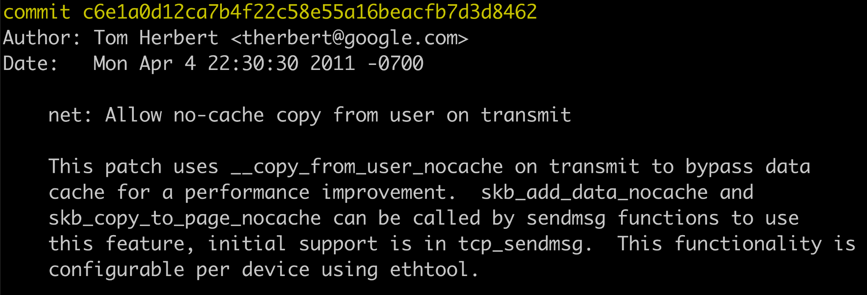

Slide 34
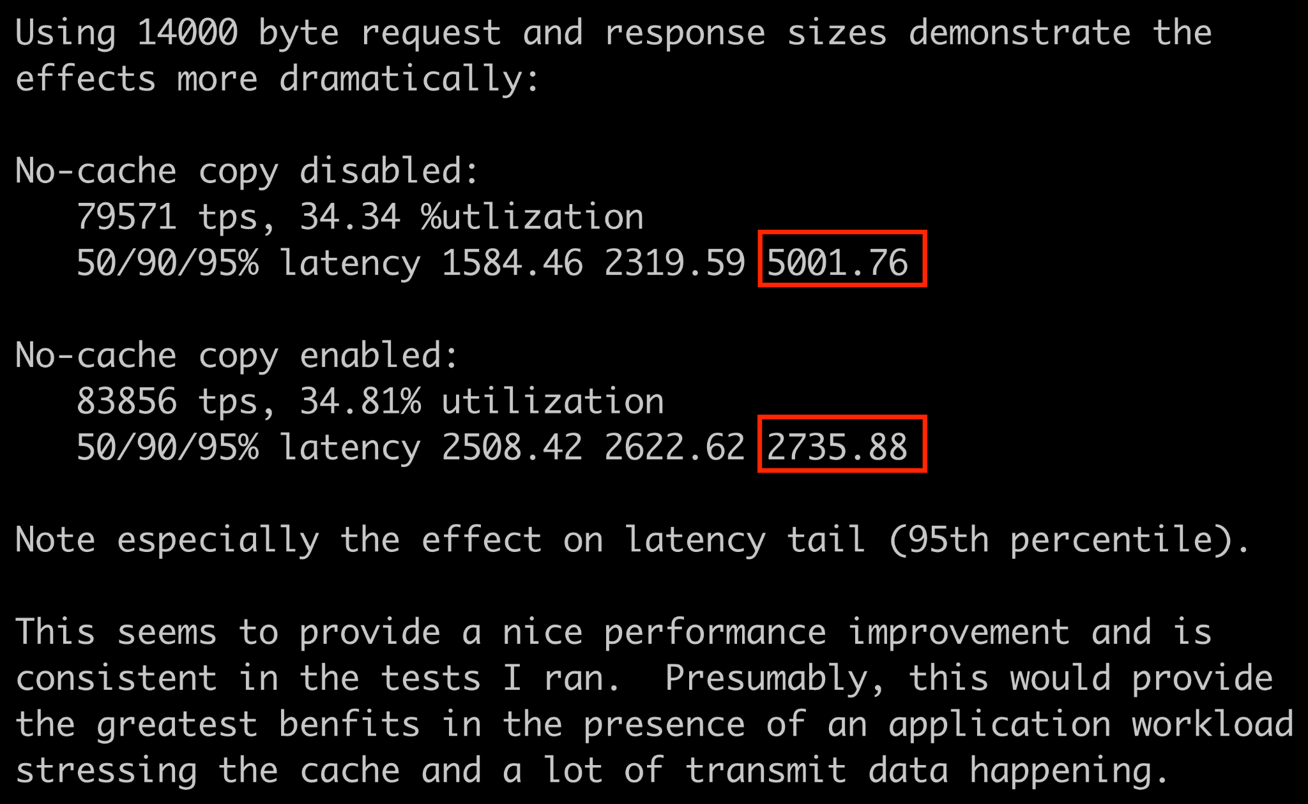

Slide 35
The original author noted a ~45% improvement in p95 times - cool!

Slide 36
BUT…

Slide 37
But:
It only affects TCP
It’s interface wide, so it affects every connection
Seems undesirable in some situations (like software kTLS)

Slide 38
AND…

Slide 39
Other:
hardware
kernel features
application architectures
protocols
address families
Invite interesting use cases which the existing mechanism doesn’t support

Slide 40
An example of a common app architecture pattern

Slide 41
One machine
Reverse proxy
Backend app
Client requests
Unix socket
Server responses

Slide 42
What typically happens is…

Slide 43
One machine
Reverse proxy
Backend app
write
read
Client requests
read
Unix socket

Slide 44
Backend app does some processing and generates the response….

Slide 45
One machine
Reverse proxy
Backend app
read
write
Server response
write
Unix socket

Slide 46
With lots of buffers being read and written
And thus lots of CPU cache being churned
Even for plain text HTTP, where the proxy doesn’t do much

Slide 47
Is there a way to do this with:
Less data movement (thus less cache churn)
For specific connections
For more than just TCP

Slide 48
What if:
sendmsg was extended to allow the application to decide when a non-temporal (NT) write is needed?

Slide 49
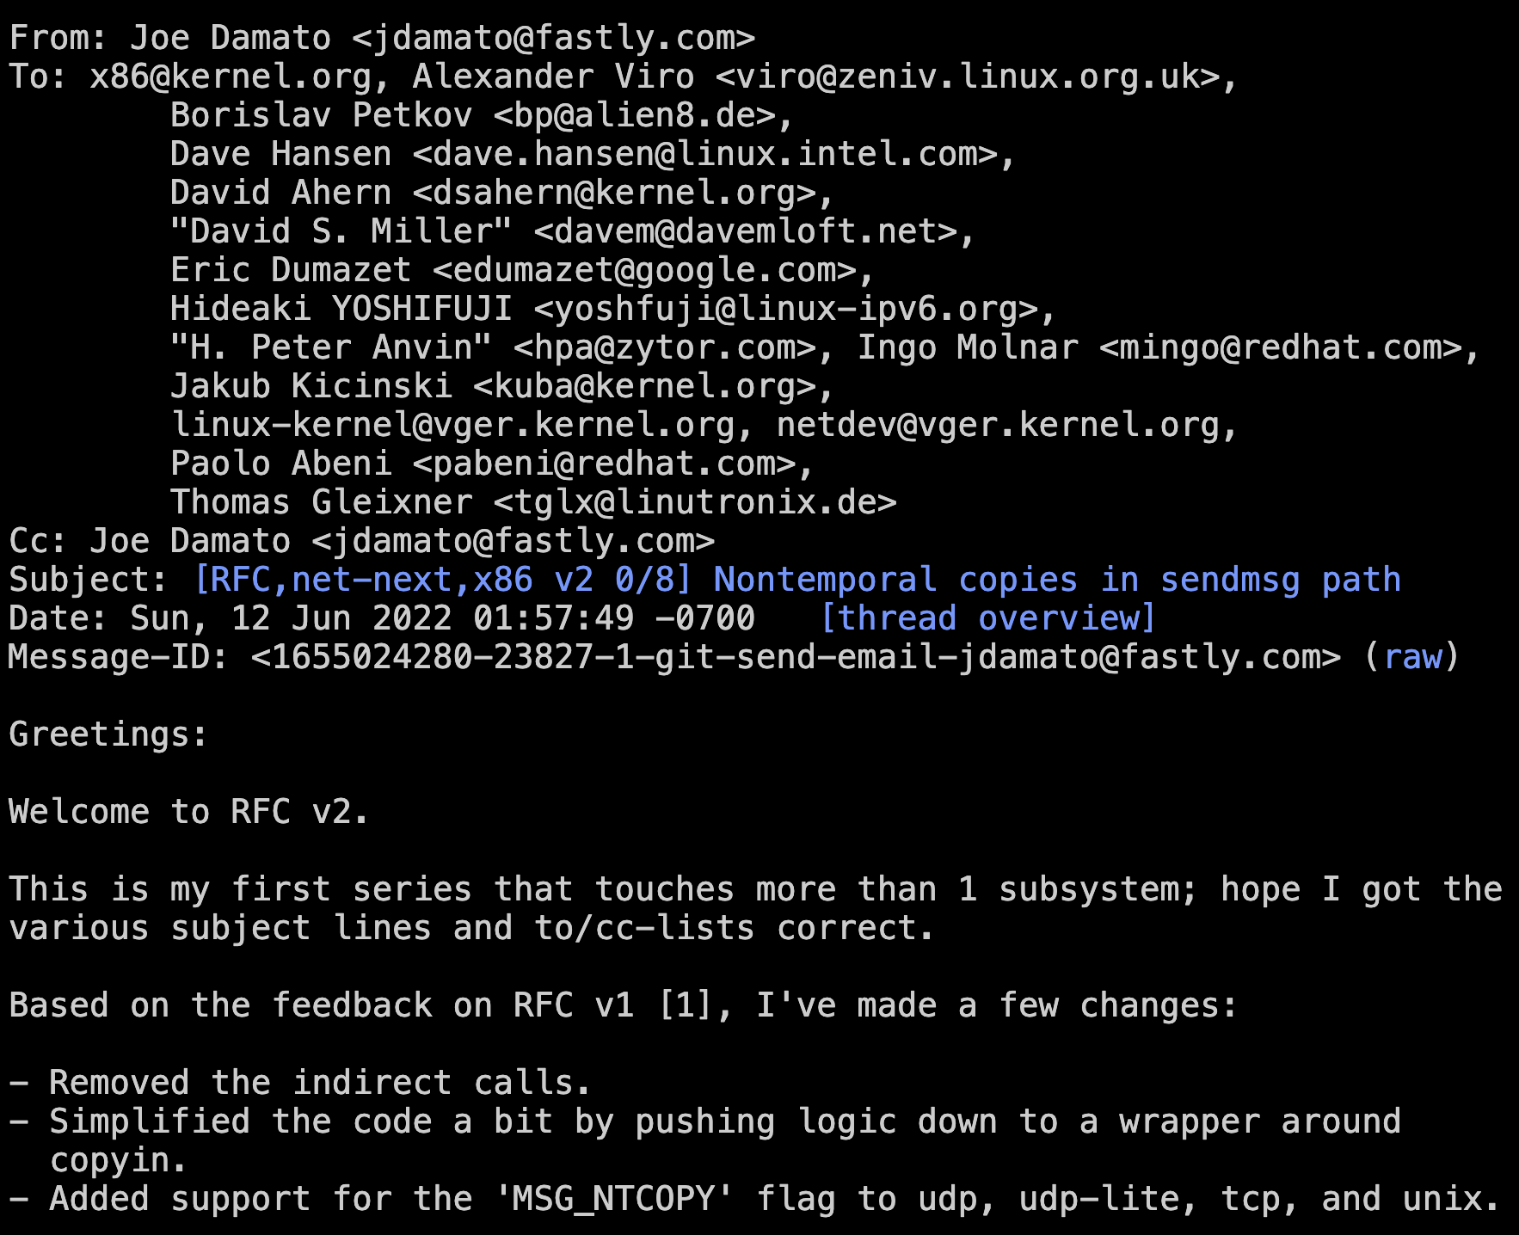
I submit an RFC to add a new sendmsg flag, MSG_NTCOPY.

Slide 50
The idea is:
User apps know when they will or won’t need temporal locality
Support more than just TCP
Allow for preservation of CPU cache contents in common app architecture patterns

Slide 51
Let’s look at 1 specific use case with disproportionate benefit:
Plain text http1

Slide 52
One machine
Reverse proxy
Backend app
plain text h1 requests
Unix socket
Plain text h1 responses

Slide 53
One machine
Reverse proxy
Backend app
write
read
Client h1 plain text requests
read
Unix socket

Slide 54
The backend app “knows” the request is plain text h1
Using the RFC, we can avoid dirtying the cache and save memory bandwidth:
sendmsg(unix_fd, msg, MSG_NTCOPY)

Slide 55
One machine
Pipe buffer
splice to client socket
2. Splice to pipe buf
NT write
response
NT write headers to
client socket
Unix socket
Reverse proxy
Backend app

Slide 56
The backend “knows” the request is plain text
Backend uses a non-temporal write to the unix socket
Reverse proxy uses:
Non-temporal write for headers
splice for the body

Slide 57
And so ….

Slide 58
In this particular scenario, we avoid disrupting the cache:
NT-write from backend to unix socket
NT-write from reverse proxy to client
splice the body from pipebuf to client

Slide 59
The entire time the CPU cache remains undisturbed as much as possible.
Hot application data stays resident.

Slide 60
OK what about TLS ?

Slide 61
One machine
3. Software TLS (libssl, etc)
NT write
2. Read
response
NT write
Unix socket
Reverse proxy
Backend app

Slide 62
In this case, the backend app preserves the CPU cache as much as it can.
Reverse proxy wants the data in cache so that TLS will be fast
Still can do an NT-write to output.

Slide 63
Many other cases where NT flexibility is helpful:
kTLS (hardware offloaded vs software)
QUIC (UDP)

Slide 64
Benchmark data !

Slide 65
Microbenchmark
Based on existing unix_thr benchmark
fork():
parent does NT write to unix socket
child does splice to pipebuf + splice to /dev/null
Lots of command line flags to benchmark different sizes

Slide 66
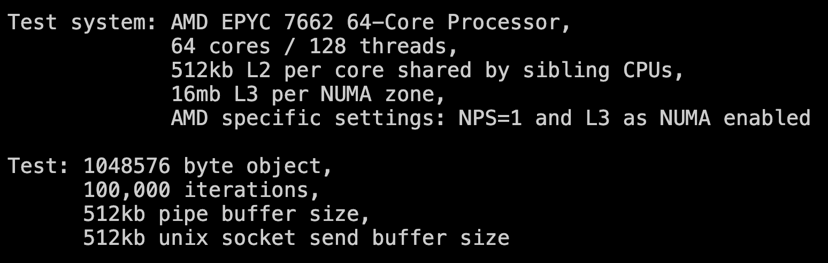
From the RFC

Slide 67
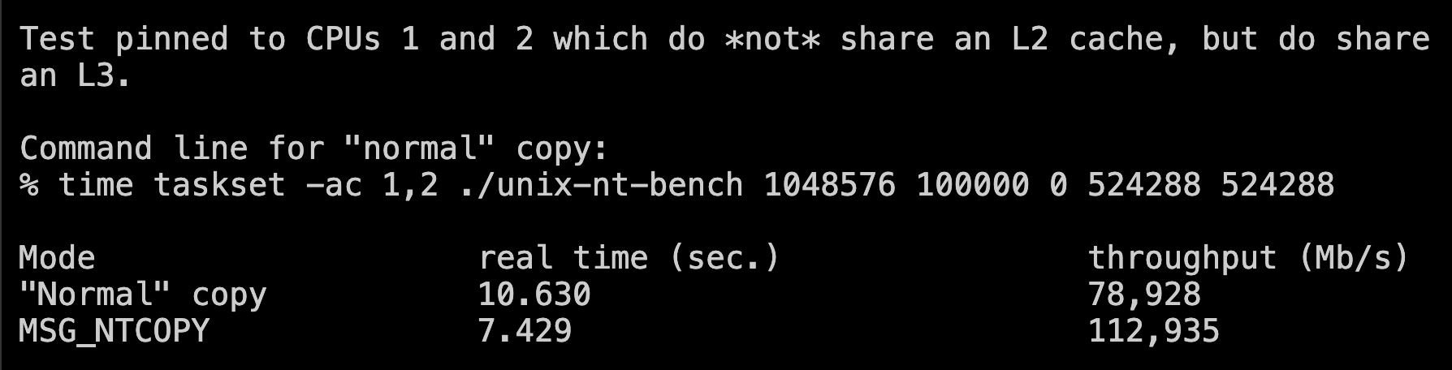
From the RFC
(~43% increase in throughput!)

Slide 68
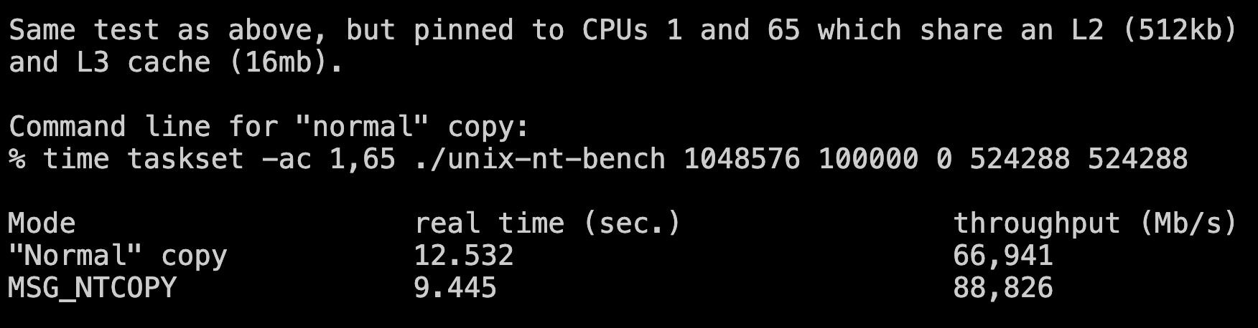
From the RFC
(~33% increase in throughput!)

Slide 69
These numbers definitely seem bizarre so it’s not surprising that I got this response on the mailing list….

Slide 70
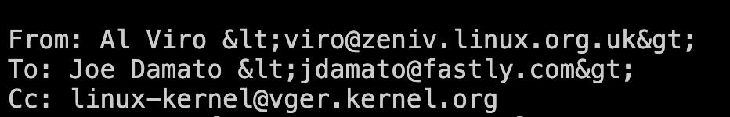
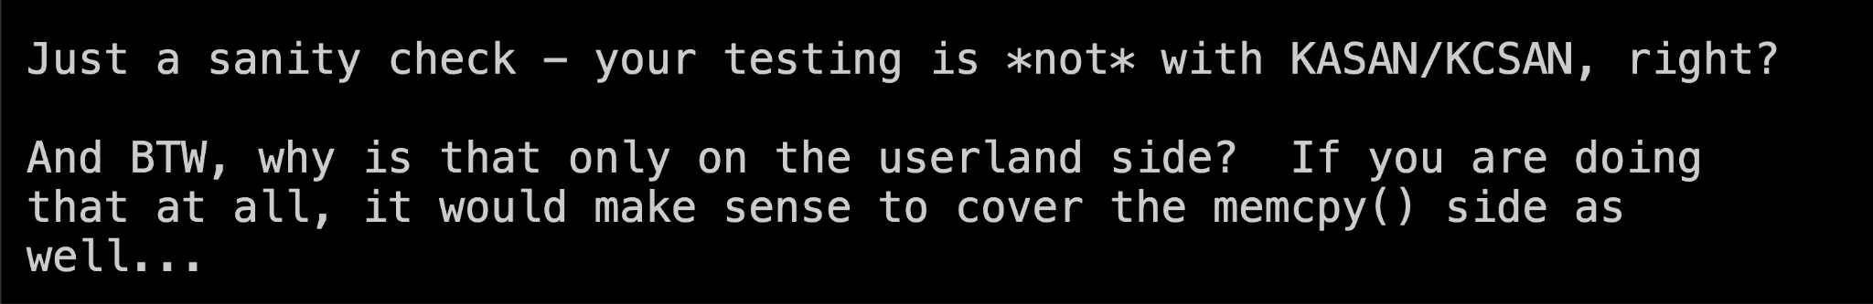

Slide 71
(We’ll come back to the memcpy bit in a moment)

Slide 72
Micro benchmarks show a huge improvement.
What about an HTTP workload benchmark?

Slide 73
HTTP benchmark uses reverse proxy + backend architecture pattern

Slide 74
One machine
Reverse proxy
Backend app
Client requests
Unix socket
Server responses

Slide 75
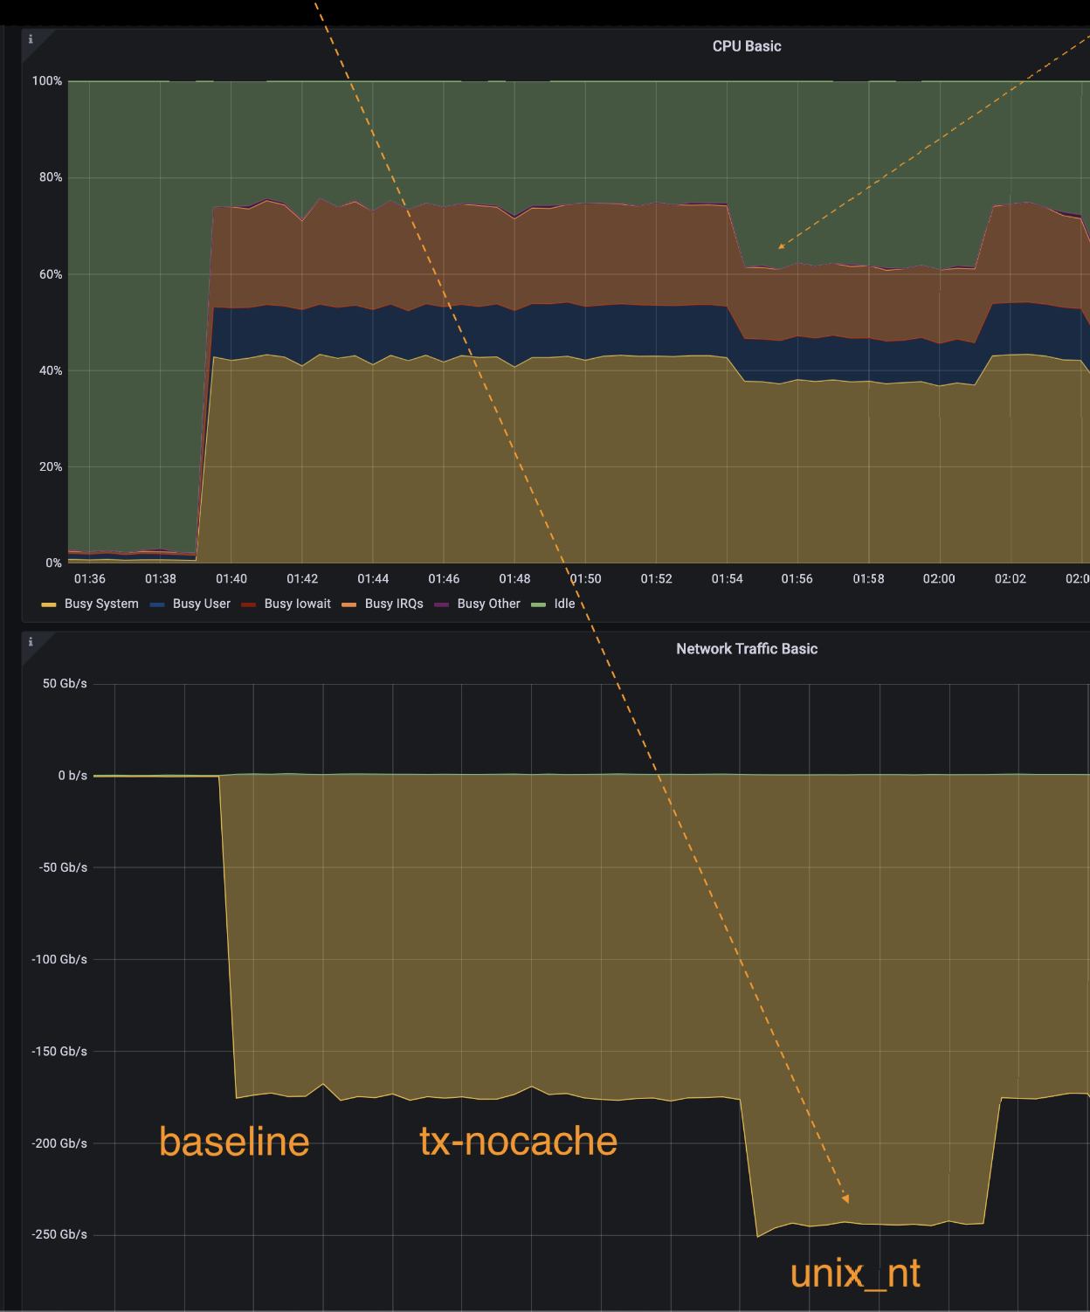
Sorry I know this is hard to see, but:
Plain text http 1
Reverse proxy + unix socket + backend
170 gbps in “normal” copy mode
245 gbps in when NT copy mode enabled
And a CPU usage drop
NT write enabled
CPU usage drop

Slide 76
tx-nocache-copy ON
Doesn’t help in this benchmark because the reverse proxy is already using splice (and not touching the data on TX).

Slide 77
Using sendmsg MSG_NTCOPY does help
An NT copy into the unix socket preserves the cache and generates less memory bandwidth traffic

Slide 78
170 gbps normal copy
245 gbps NT copy
~44% increase in throughput

Slide 79
What about DDIO (Intel CPUs) ?

Slide 80
DDIO allows DMA directly from cache. Thus, non-temporal writes may not be useful if buffers are sized properly.
This is CPU and application specific. Users should be aware that DDIO will affect their results.

Slide 81
If your CPU (Intel) has DDIO support, I strongly recommend reading this paper to learn more about networking performance with DDIO.

Slide 82
So if this is true in the kernel:
what about memcpy in userland?
(which is what I think Al Viro was asking?)

Slide 83
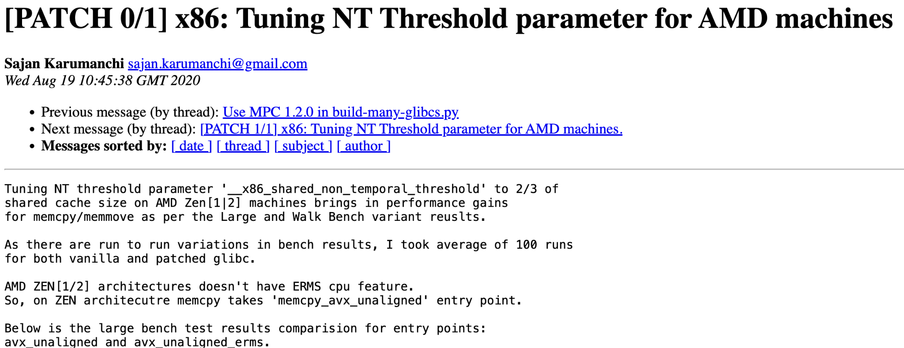
glibc tunable for memcpy/memmove

Slide 84
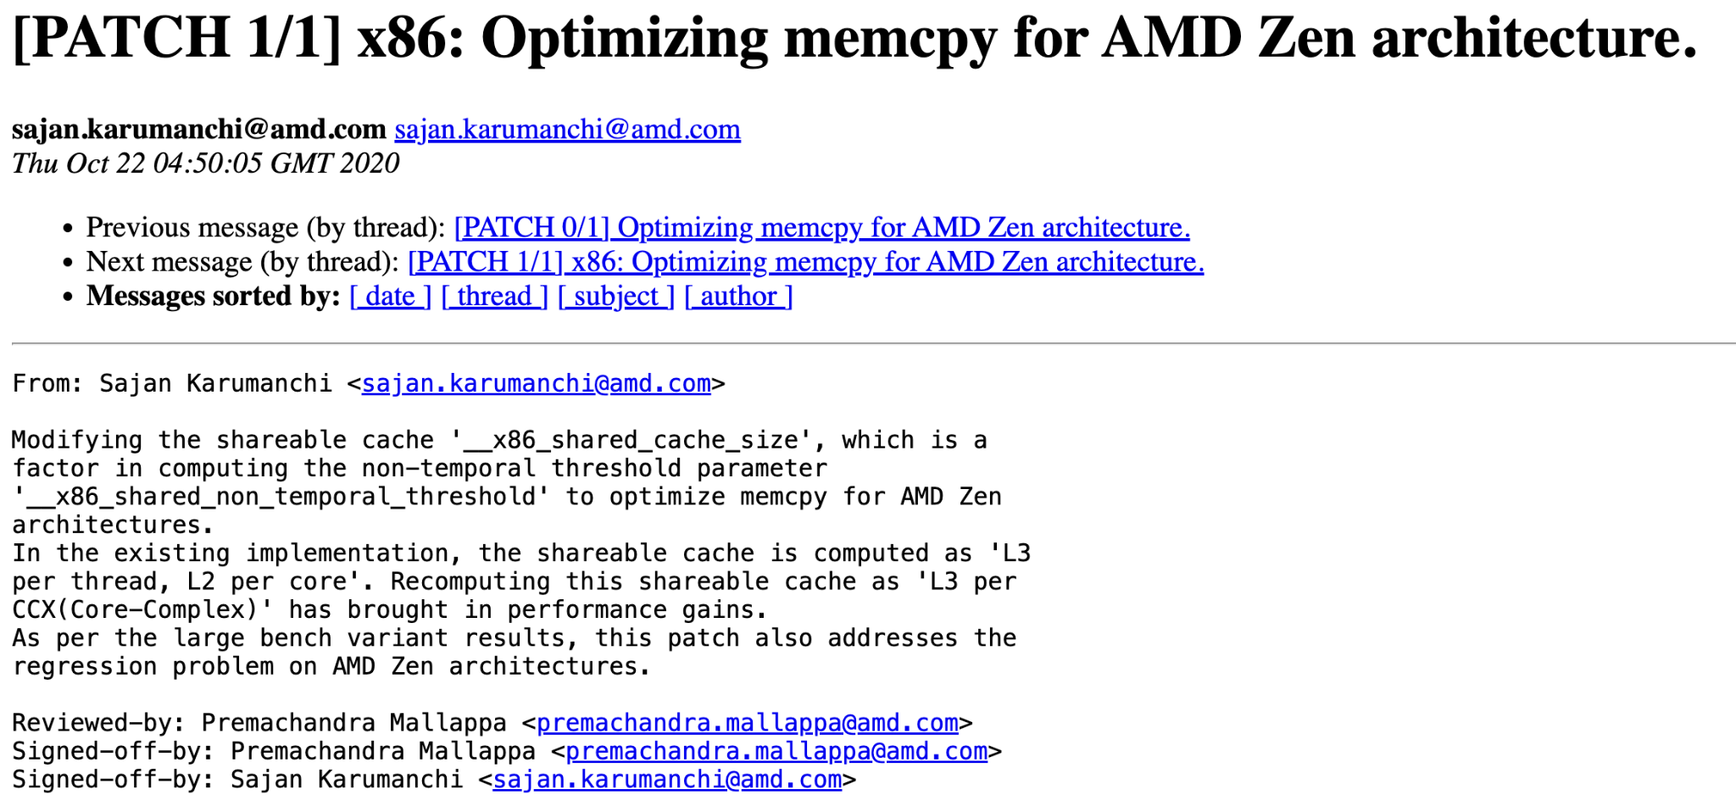
glibc tunable for memcpy/memmove

Slide 85
More recently, Noah Goldstein from Intel has been investigating NT writes for memset

Slide 86
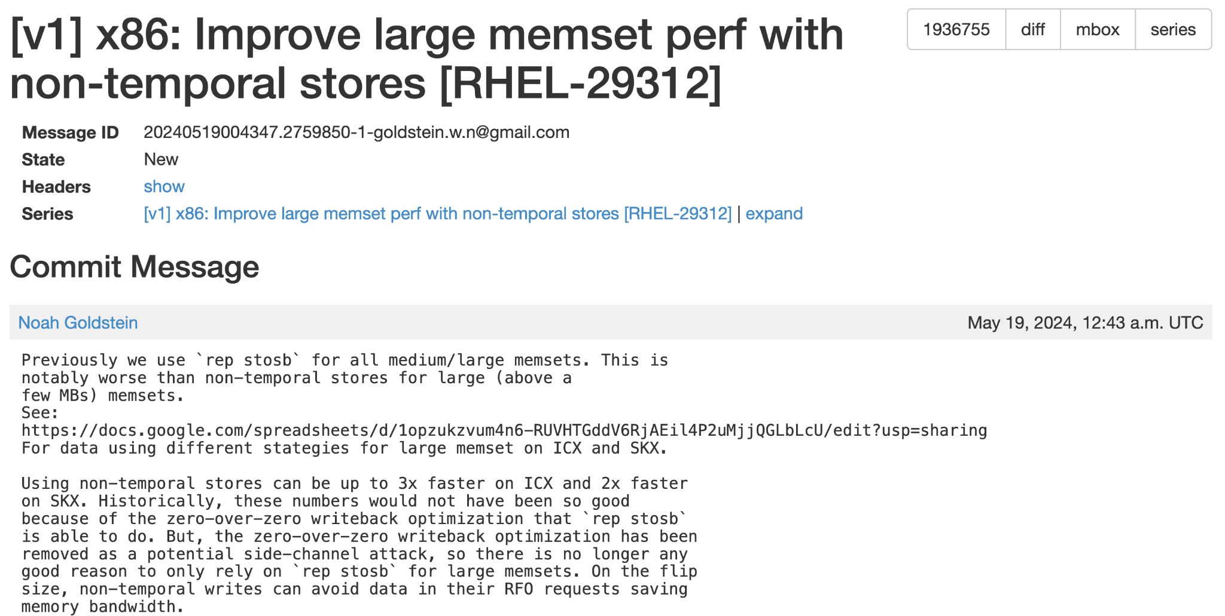
glibc tunable for NT memset (intel only)

Slide 87
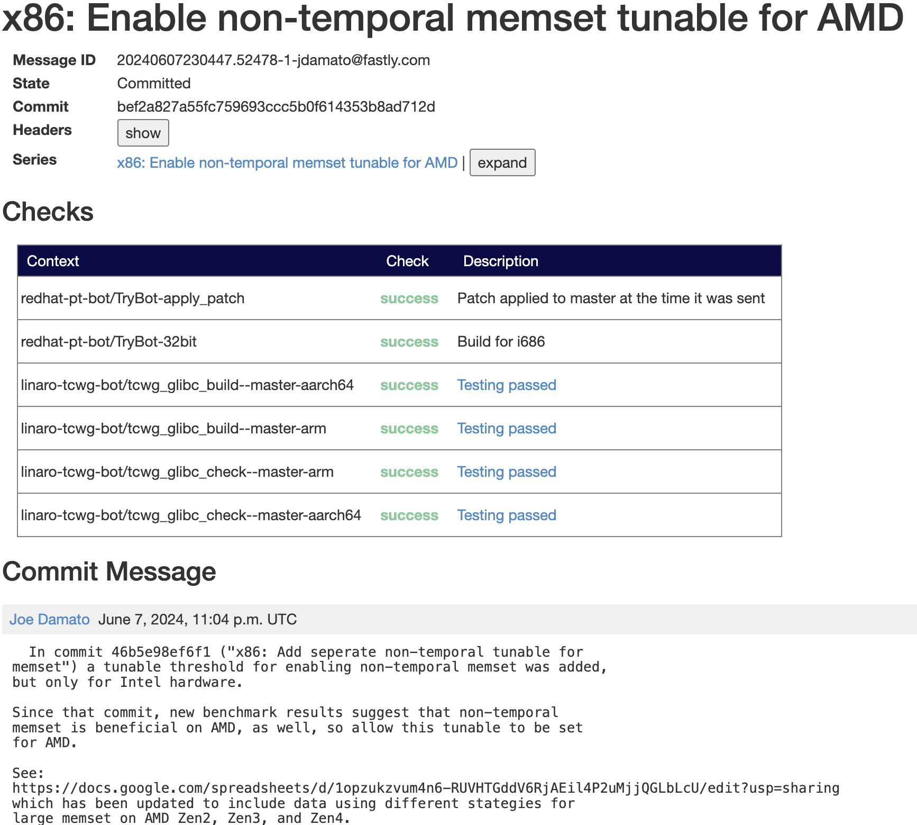
glibc tunable for NT memset (AMD support)

Slide 88
If you are super curious, Noah has been compiling a spreadsheet of memset performance across many different CPUs.

Slide 89
In conclusion:
tx-nocache-copy is useful for a very narrow set of applications
Applications “know” when they don’t need temporal locality
glibc has tunables for NT writes in memcpy and memset
Microbenchmarks and http benchmarks show a performance boost

Slide 90
Maybe:
sendmsg should be extended to allow user applications to decide if their writes should or should not have temporal locality?

Slide 91
?

