Slide 1

CXL benchmarking
Viacheslav Dubeyko
Adam Manzanares

Slide 2
Content
Problem declaration
Potential target use-cases
Emulation of target use-cases
Emulation of different types of CXL memory and CXL device types
Benchmarking framework
Benchmarking results interpretation
Open questions

Slide 3
CXL benchmarking problem
Determination allocation policy and memory access pattern(s) capable of improving an application performance
Determination memory (CXL) configuration and migration policy capable of decreasing a total latency of particular memory access pattern
Emulation of CXL infrastructure with the goal of determination an efficient configuration
Detection of CXL infrastructure bottlenecks
Continuous detection/management of CXL infrastructure latency/performance degradation
Elaboration of CXL infrastructure architecture capable of decreasing TCO cost

Slide 4
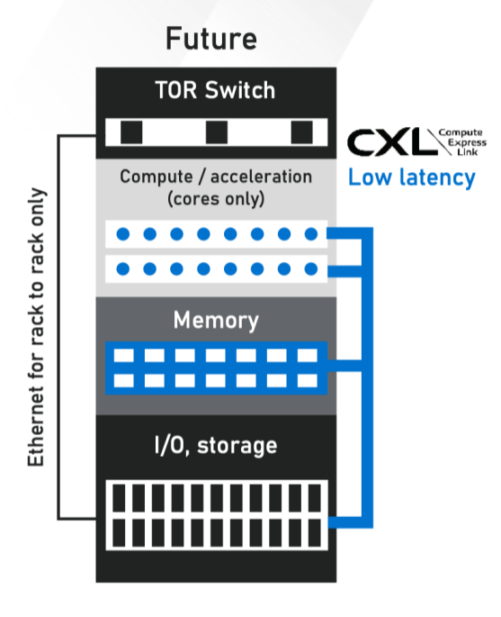
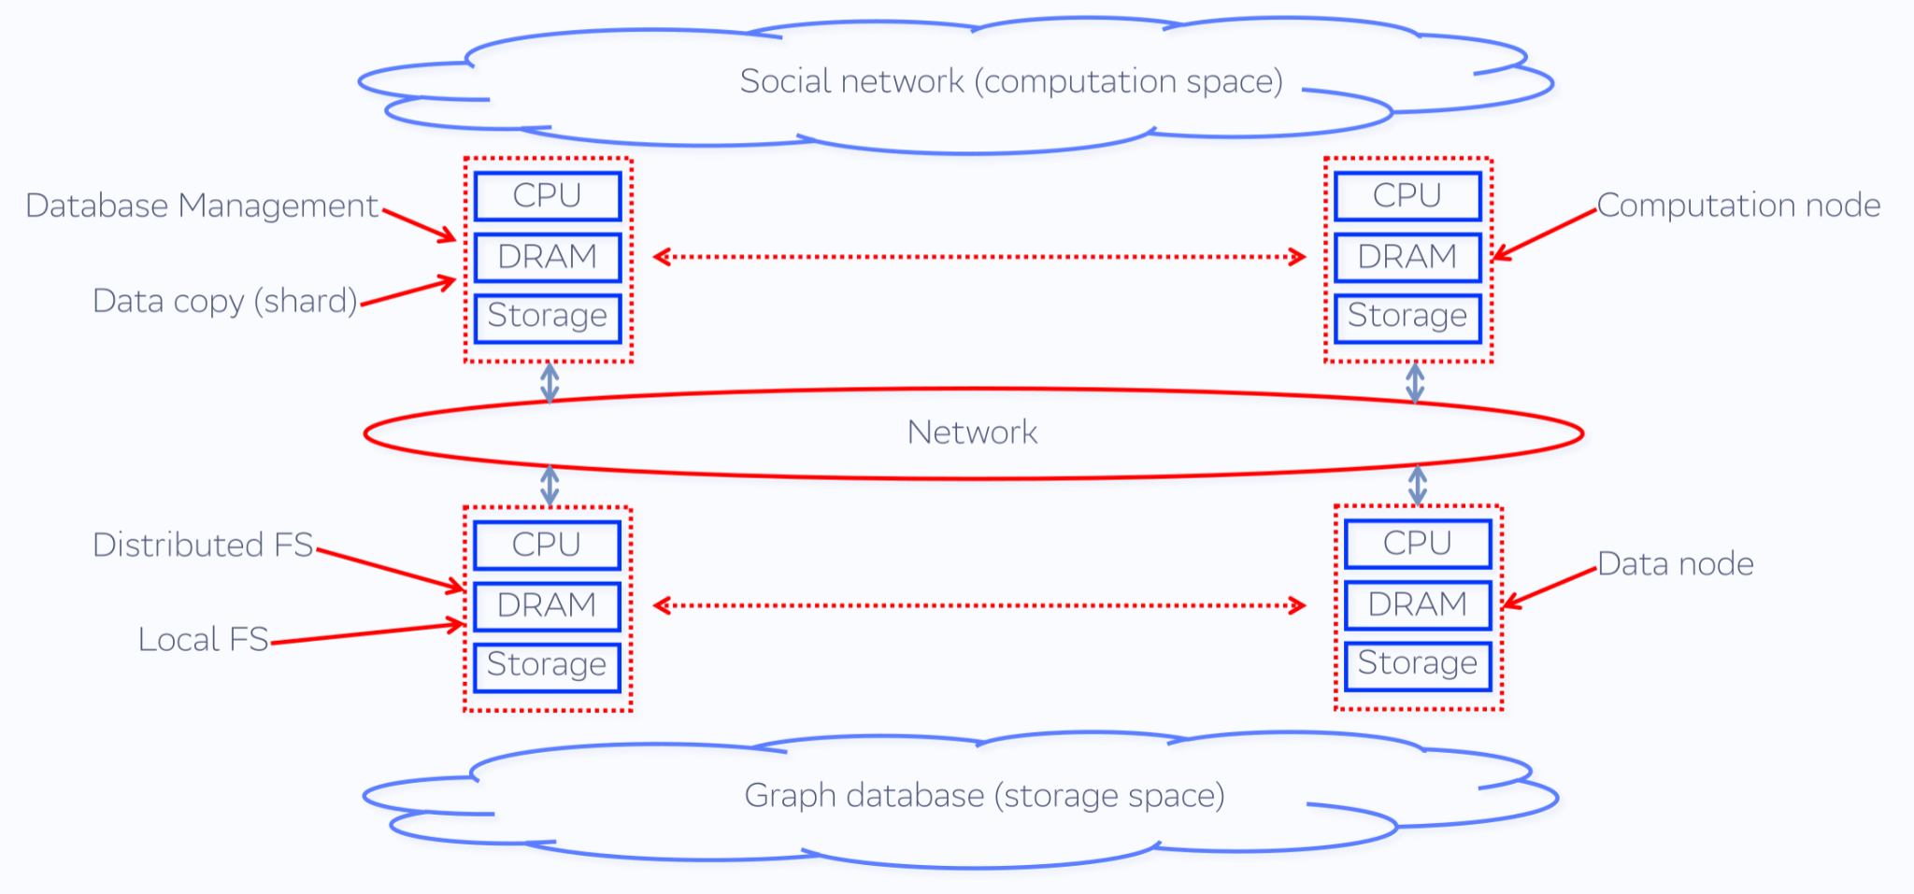
Potential target use-cases
Huge relational and NoSQL databases
In-memory database
Social networks
AI/ML workloads

Slide 5
Target use-cases emulation problem
…
Thread 1
Thread 2
Thread n
Memory
Read/
write
Time
Allocate
Allocate
Free
Read/
write
Free
Memory access pattern

Slide 6
Memory access patterns emulation
Time gap between operations
Allocated memory migration
Threads number
Allocation/Free size
Memory access pattern
Read size
Access size
Write size
Memory type selection

Slide 7
Optimization problem
Application memory access pattern (not optimized)
Pattern 1
Pattern 2
Pattern 1
Pattern 2
…
Pattern n
Time
Pattern 1
Pattern 2
Pattern 1
Pattern 2
…
Pattern n
Optimization
Application memory access pattern (optimized)

Slide 8
Optimization problem
Y = f(X)
{Capacity 1, …, Capacity n, Allocation policy} = f{Access pattern, Latency 1, …, Latency n}
Memory 1
Capacity 1
Latency 1
Memory 2
Capacity 2
Latency 2
Memory 3
Capacity 3
Latency 3
Memory n
Capacity n
Latency n
…
Switch 1
Switch n
Local DRAM
Local CXL
…
Persistent memory
Remote CXL 1
Remote CXL n

Slide 9
Optimization workflow
Monitoring memory access parameters
Repeatable memory access patterns detection
Memory access patterns classification (frequency + duration)
Select (prioritize) memory access patterns for optimization
Pattern analysis and detection of area(s) for optimization
Simulation of memory accesses distribution on various memory types
Best outcome searching
Interpretation and feasibility analysis of the found best outcome
Elaboration allocation and memory migration policy among memory tiers
Testing optimization policy

Slide 10
CXL memory types emulation
NUMA nodes [1, 6]
Hardware prototype [2, 3, 4]
RAMdisk on remote nodes [5]
QEMU-based emulation [7]
Mathematical model + empirical estimation???
HDD, SSD -> swap
List data structure as latency management
List data structure as latency management
Swap (persistent memory)
NUMA nodes
Hardware prototype
RAMdisk (remote node)
QEMU-based emulation
Mathematical model???
1
2
3
4
5
Li, Huaicheng, et al. ”Pond: CXL-based memory pooling systems for cloud platforms.” Proceedings of the 28th ACM International Conference on Architectural Support for Programming Languages and Operating Systems, Volume 2. 2023.
Gouk, D., Lee, S., Kwon, M. & Jung, M. Direct Access, High-Performance Memory Disaggregation with DirectCXL. 2022 USENIX Annual Technical Conference (USENIX ATC 22). pp. 287-294 (2022,7)
M. Jung, ”Hello bytes, bye blocks: PCIe storage meets compute express link for memory expansion (CXL-SSD)”. In Proceedings of the 14th ACM Workshop on Hot Topics in Storage and File Systems (HotStorage ’22). Association for Computing Machinery, New York, NY, USA, 45–51.
M. Ahn et al., “Enabling CXL memory expansion for in-memory database management systems,” Data Management on New Hardware, 2022.
M. D. Flouris, E. P. Markatos. ”The Network RamDisk: Using remote memory on heterogeneous NOWs”. Cluster Computing 2, 4 (1999), 281–293.
Wahlgren, J., Gokhale, M. & Peng, I. Evaluating Emerging CXL-enabled Memory Pooling for HPC Systems. ArXiv Preprint ArXiv:2211.02682. (2022)
Raja Gond and Purushottam Kulkarni, emucxl: an emulation framework for CXL-based disaggregated memory applications. ArXiv Preprint arXiv:2404.08311 (2024)

Slide 11
Potential memory type selection policies
Priority-based allocation policy
higher priority in local DRAM, lower priority in CXL memory
Size-based allocation policy
smaller sizes in local DRAM, bigger sizes in CXL memory
Pre-fetch based allocation policy
pre-fetching from persistent memory into CXL memory
Pre-allocation based policy
pre-allocation big chunks of memory (memory pool) in CXL memory
Pre-mapping based policy
page faults elimination by pre-mapping physical memory pages for virtual address space
Lifetime based allocation policy
short-lived memory chunks in local DRAM, long-lived memory chunks in CXL memory
application-based hints on memory chunks’ lifetime
lifetime-based memory heaps (short-lived, long-lived memory pools)

Slide 12
Potential allocated data migration policies
Dynamic lifetime-based policy
initial allocation from short-lived memory pool (local DRAM)
growing lifetime initiates migration in longer-lived memory pools (CXL memory)
Swap-based migration policy
swapping from local DRAM into CXL memory
File system like interaction between local DRAM and CXL memory
pre-fetching portion of CXL memory content into local DRAM
hardware-based management???

Slide 13
CXL benchmarking framework
Memory access pattern detection tool
Memory access pattern emulation tool
APP
CXL memory emulator
Optimization tool
(ML based)
CXL infrastructure
Benchmarking tracing tool

Slide 14
CXL Fabric Manager (FM) as benchmarking subsystem
Host #1
App #1
…
CXL switch #1
App #n
CXL FM
Disaggregated
CXL memory
pool
…
…
ML subsystem
continuous benchmarking
+
policy elaboration
Host #n
App #1
…
CXL switch #n
App #n

Slide 15
Open questions
How to emulate memory latency?
How to emulate application behavior?
How to estimate application performance?
How to treat benchmarking results?
How good is “good” numbers?
How bad is “bad” numbers?
Isolated workload vs. real-life environment?
How to identify and isolate code patterns determining application behavior sensitive to memory allocation types?
How feasible is implementation of found best optimization outcomes?
How useful can be an abstractness of mathematical model?

Slide 16
THANK YOU QUESTIONS???

Slide 17
Allocate/free memory patterns
Set of typical allocation sizes
Set of typical lifetimes of allocated memory
Application
Distribution of allocation with time
Distribution of deallocation with time
Variation of distribution with time

Slide 18
Read/write memory patterns
Set of typical access sizes
Types of accessed memory (volatile, persistent)
Set of typical latencies
Application
Distribution of accesses with time
Total/average time gap between memory accesses
Distribution of time gaps with time

Slide 19
CXL benchmarking framework
(1) Record application’s memory access pattern
(2) Reproduce (emulate) + benchmark an application’s memory access pattern
(3) Analyze and recognize memory access sub-patterns
(4) Classify sub-patterns on the basis of frequency, latency, and priority
(5) Select sub-patterns for optimization
(6) Analyze sub-patterns peculiarities + select optimization techniques
(7) Emulate application’s memory access patterns with optimized sub-patterns
(8) Benchmark application’s memory access patterns on emulated CXL memory
(9) Normalize benchmarking results
(10) Detection of responsible programming patterns and feasibility of optimization

Slide 20
Correct latency and performance estimation problem
Record memory access pattern
Distinguish memory allocation and memory access subpatterns
How to emulate memory latency?
How to emulate application behavior?
How to estimate application performance?
How to treat benchmarking results?
Redistribution memory allocation among memory tiers
Memory type latency emulation
Memory access reproduction
Benchmarking memory access pattern

Slide 21
Benchmarking result interpretation problem
How good is “good” numbers?
How bad is “bad” numbers?
Measured numbers variation
Latency emulation approach
Measurement approach
Approach of redistribution memory allocation among tiers
Abstractness of mathematical model
Isolated workload vs. real-life environment?
How to identify and isolate code patterns determining application behavior sensitive to memory allocation types?
How feasible is implementation of found best optimization outcomes?

