Slide 1

SSDFS: ZNS/FDP ready LFS file system saving your space and decreasing TCO cost
Viacheslav Dubeyko
SSDFS.ORG

Slide 2
Content
What is the point of SSDFS?
Recently implemented and stabilized features
Current status and upstreaming plans
Planned new features

Slide 3
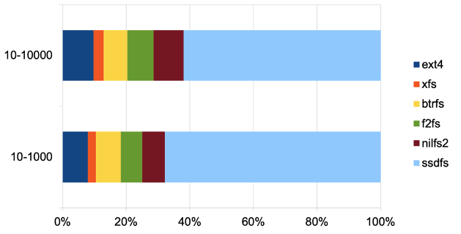
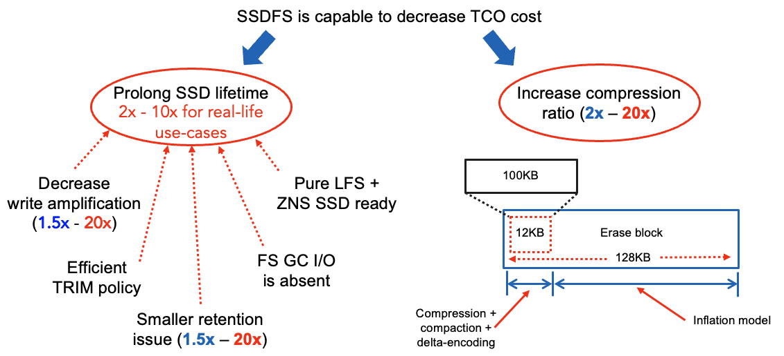
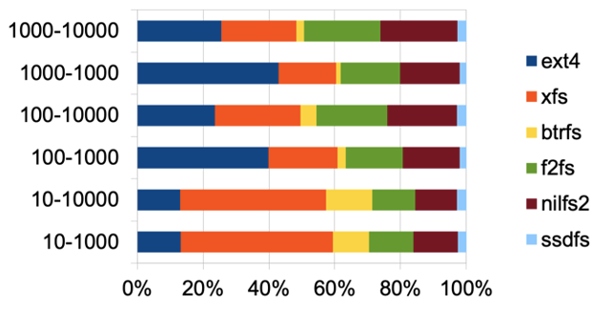
What is the point of SSDFS?
SSDFS can prolong SSD lifetime
2x - 10x for real-life use-cases
SSDFS is capable to generate smaller amount (1.5x - 20x) of write I/O requests comparing with other file systems.
SSDFS.ORG

Slide 4
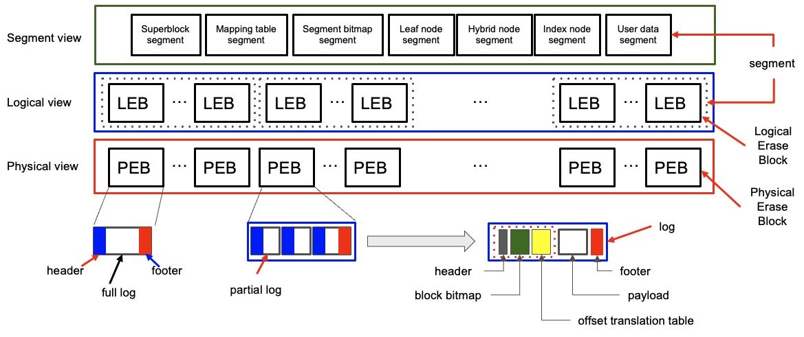
SSDFS architecture (logical vs. physical view)
SSDFS.ORG

Slide 5
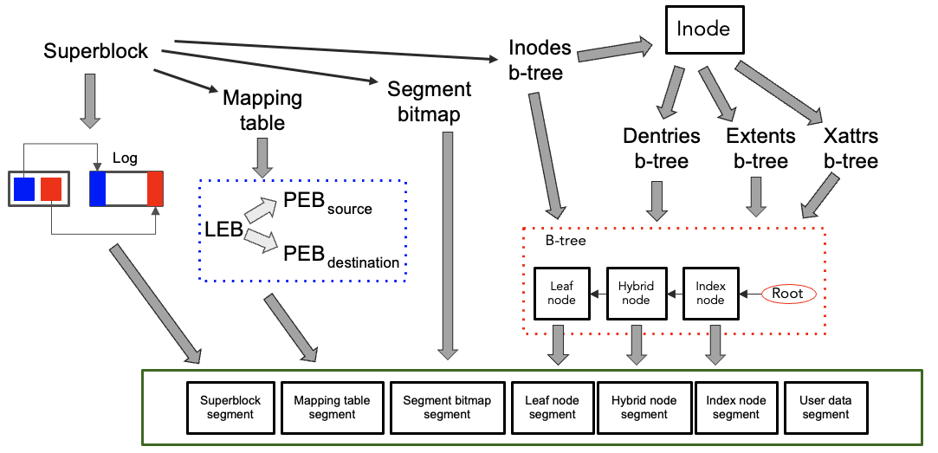
SSDFS architecture (metadata)
SSDFS.ORG

Slide 6
Recently implemented and stabilized features
Newly implemented features:
folio support
Offset translation table compression
Storing offset translation table in every log
Erase block inflation model
Erase block based deduplication
Fixed set of superblock segments
recoverfs tool
Snapshot rules
Stabilized features:
Support 8K, 16K, 32K logical block sizes
Support multiple erase blocks in segment (not fully stabilized)
SSDFS.ORG

Slide 7
Folio support
Current status:
Folio support is implemented and tested
It looks mostly stable (however, some particular issues could be found)
Finally, 8K, 16K, 32K logical block sizes support works in predictable way now
Some worries:
Technically speaking, there is no guarantee that folio of 16K or 32K will be allocated (in the case of memory fragmentation). So, file system needs to be ready to process logical block that contains several smaller folios (for example, potentially, 32K can be represented by 16K, 8K, 4K, 4K folios set)
Readahead logic doesn’t take into account the logical block size for a particular file system volume. As a result, real-life case is of having 32K folios in the page cache even if file system works with (and expects) 16K logical block sizes. Why readahead logic doesn’t take into account the logical block size?
SSDFS.ORG

Slide 8
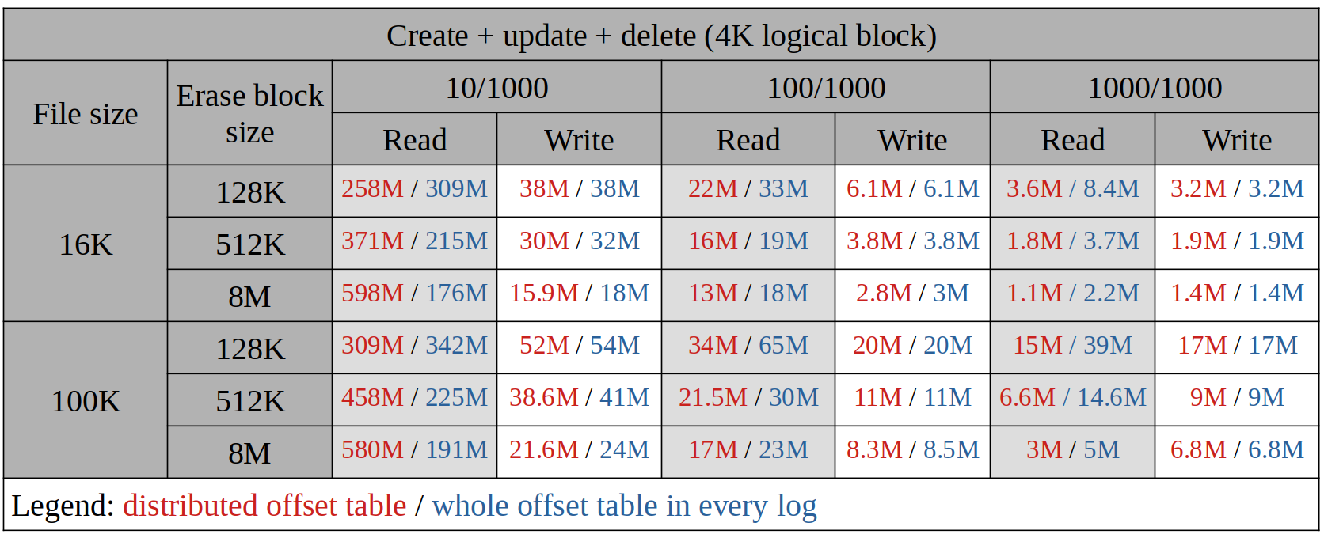
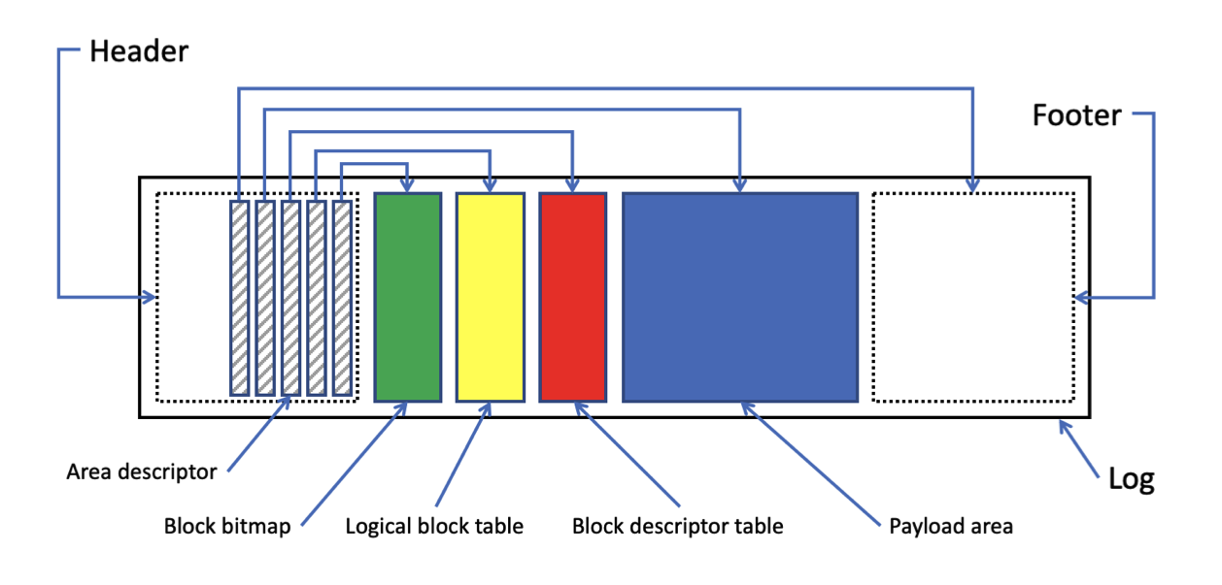
Storing offset table in every log vs. distributed model
Storing offset translation table in every log mostly doesn’t initiate more write I/O requests compared with distributed model of offset translation table
128KB, 256KB erase blocks don’t benefit from storing offset translation table in every log for the case of read I/O requests
Storing offset translation table in every log makes sense for 512K, 2MB, 8MB and bigger erase block sizes because it could reduce amount of read I/O requests 3x times
However, if number of logs per erase block is lesser than 20, then storing offset translation table in every log approach can generate more read I/O requests
“Cold” data could benefit from distributed model of offset translation table
Storing offset translation table in every log is beneficial for the case of frequently updated data.
SSDFS.ORG

Slide 9
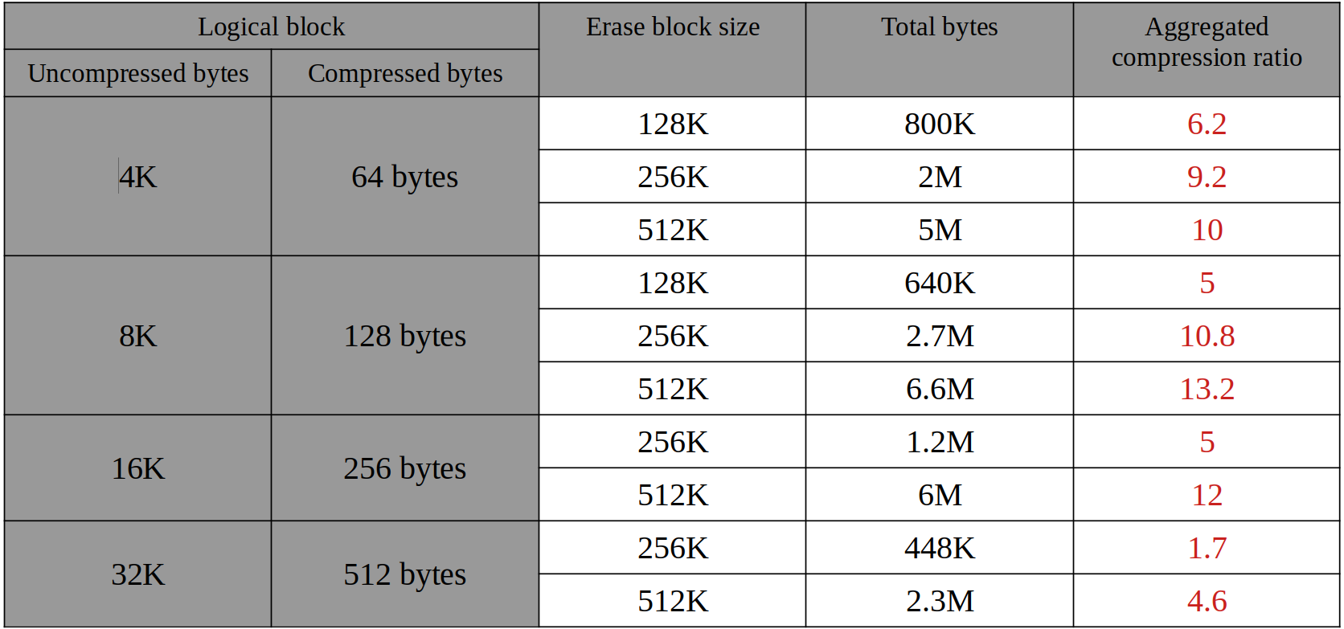
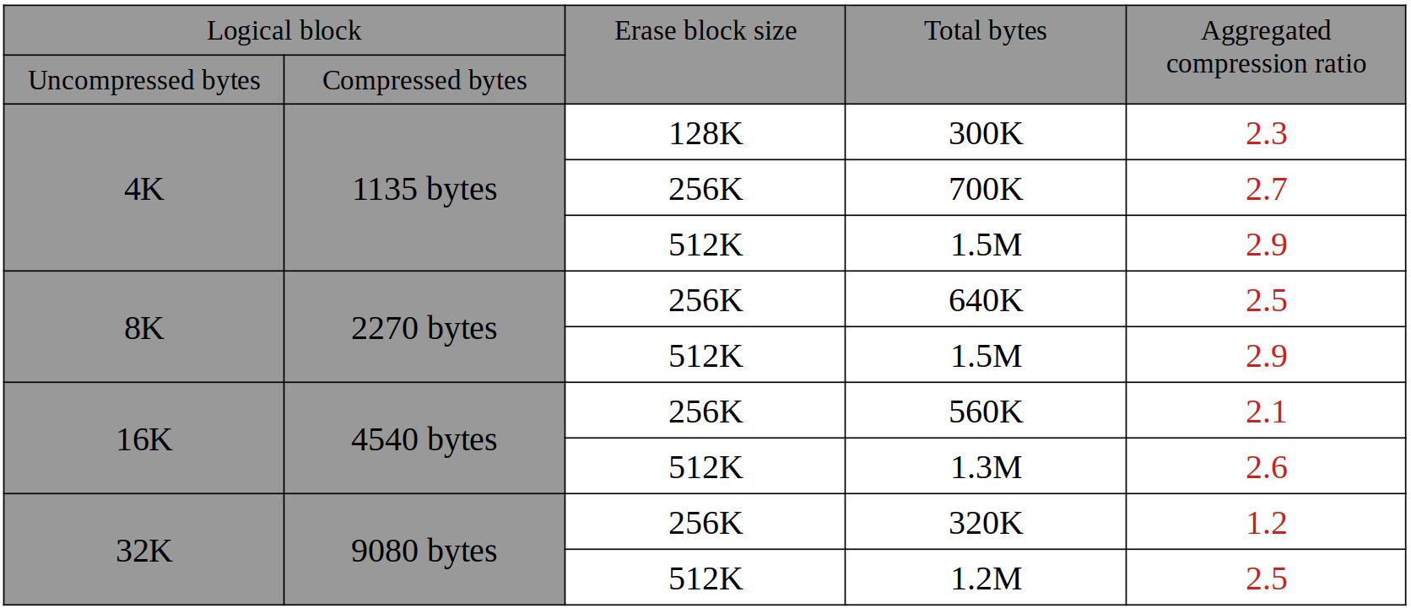
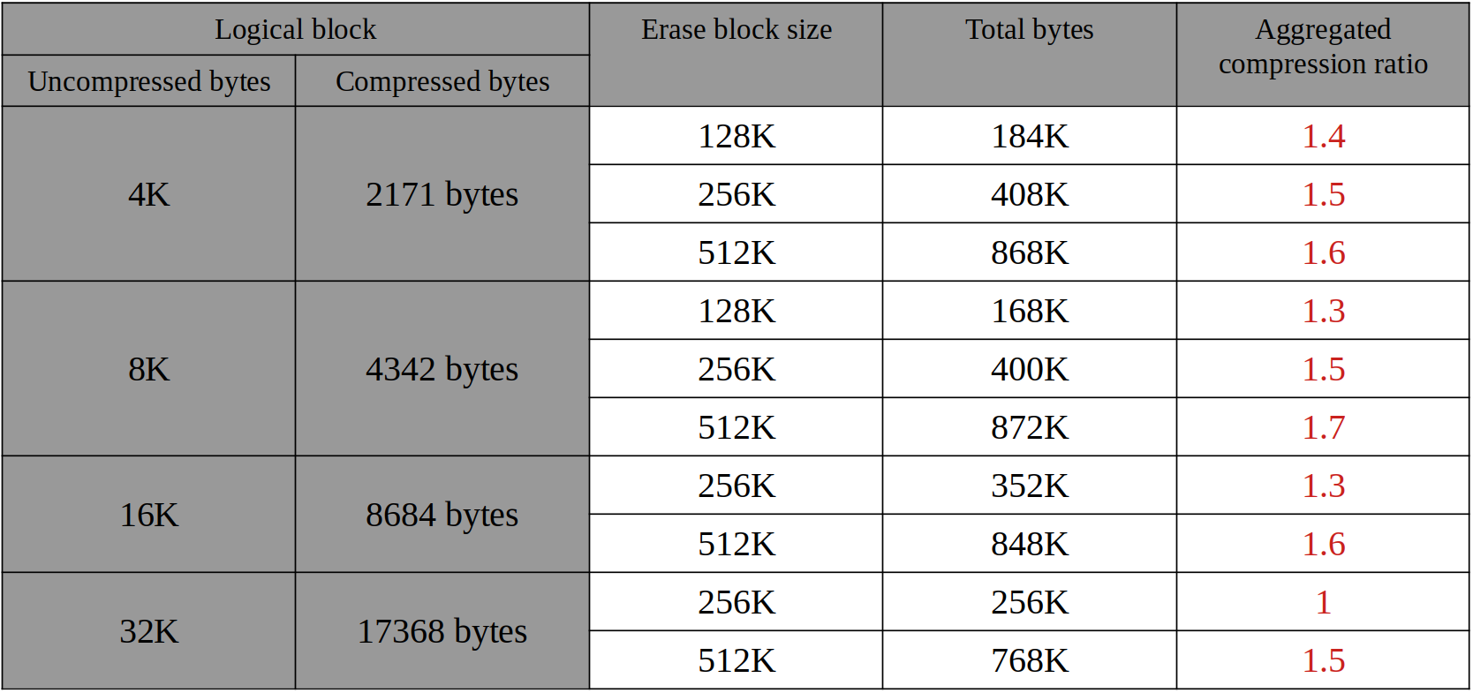
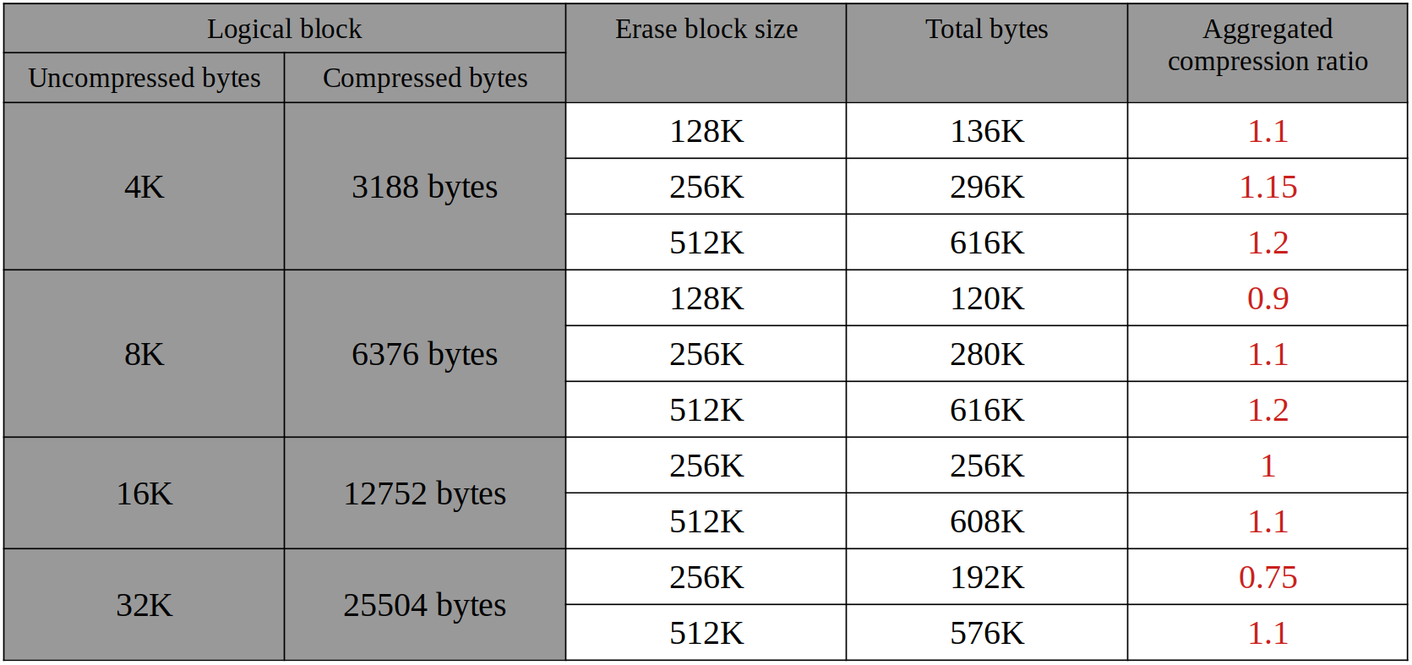
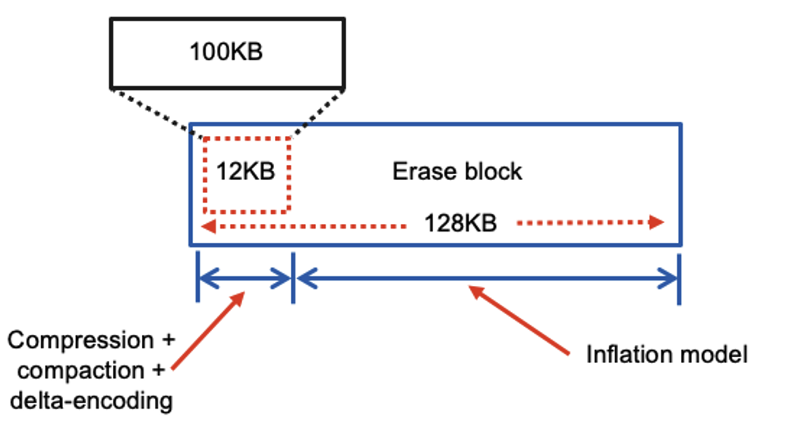
Erase block inflation model + moving scheme
Erase block inflation model is capable of storing 1.5x - 12x more data than physical capacity of erase block.
SSDFS.ORG

Slide 10
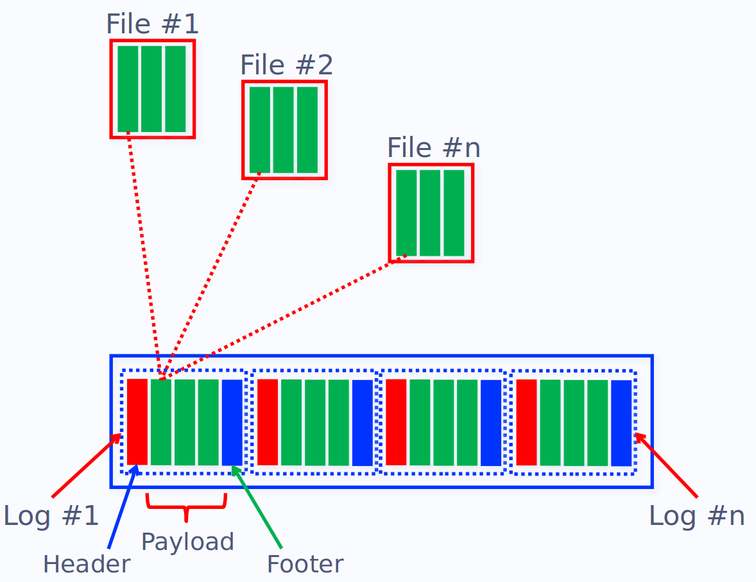
Erase block based deduplication
SSDFS.ORG

Slide 11
The recoverfs tool
struct ssdfs_block_descriptor {
__le64 ino;
__le32 logical_offset;
__le16 log_start_page;
__le8 log_area;
__le32 byte_offset;
}
recoverfs
Log 1
…
Log n
Extract
Recreate files
Erase block 1
Erase block 2
…
Erase block N
Corrupted volume
Clean volume
Copy data from corrupted volume as a last resort
SSDFS.ORG

Slide 12
Snapshot rules
Create rule
Snapshot rule
make snapshot (every sync, hour, day, week, month)
snapshot experies (in hour, day, week, month, year)
snapshotfs.ssdfs
Save rule
User-space
Kernel-space
Snapshot rules
Check rules
snapshot b-tree thread
Check snapshots expiration
sync_fs logic
Find pre-erased blocks
Remove expired snapshots
Create snapshot
snapshots b-tree
mapping table thread
Check valid snapshot(s) for erase block
Erase pre-erased blocks
SSDFS driver
SSDFS.ORG

Slide 13
Microbenchmarking: environment
CREATE:
for (i = 0; i < file_number; i++) {
touch <file_name>
dd if=./pattern1.bin of=<file_name> conv=notrunc oflag=append bs=4096 count=1
}
sync
READ:
for (i = 0; i < file_number; i++) {
md5sum <file_name>
}
UPDATE:
for (i = 0; i < file_number; i++) {
dd if=./pattern2.bin of=<file_name> conv=notrunc seek=offset bs=4096 count=1
offset += 4096
}
sync
DELETE:
for (i = 0; i < file_number; i++) {
rm <file_name>
}
sync
Linux 6.10.0 #34 SMP PREEMPT_DYNAMIC Tue Aug 13 18:50:14 MSK 2024 x86_64 x86_64 x86_64 GNU/Linux
11th Gen Intel(R) Core(TM) i5-1135G7 @ 2.40GHz
MemTotal: 32452532 kB
Model Family: Silicon Motion based SSDs
Device Model: TS128GSSD230S
User Capacity: 128,035,676,160 bytes [128 GB]
Sector Size: 512 bytes logical/physical
Rotation Rate: Solid State Device
Form Factor: 2.5 inches
TRIM Command: Available, deterministic, zeroed
ATA Version is: ACS-3 T13/2161-D revision 5
SATA Version is: SATA 3.3, 6.0 Gb/s (current: 6.0 Gb/s)
SSDFS.ORG

Slide 14
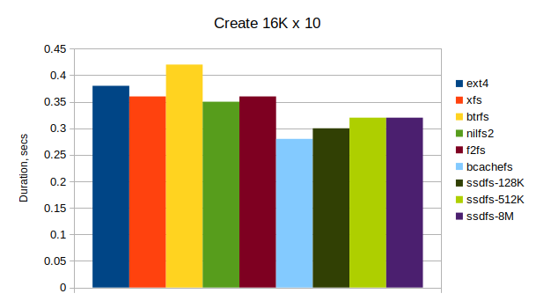
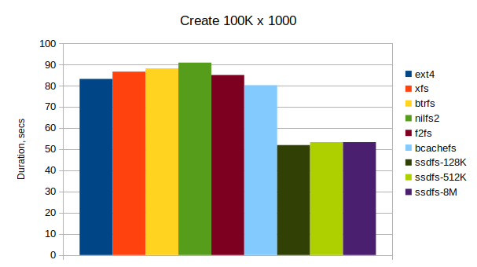
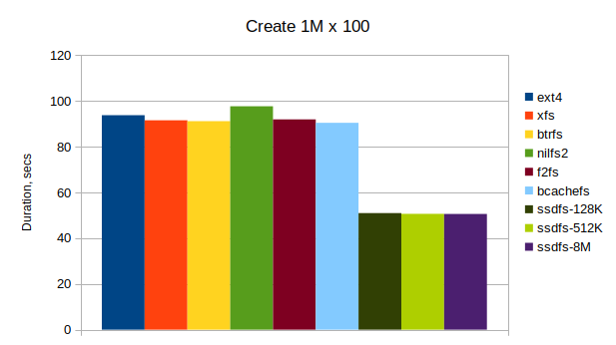
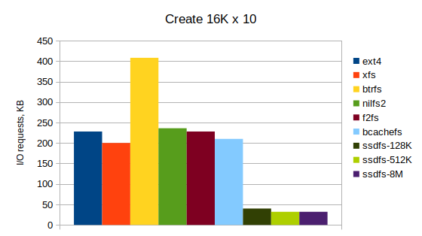
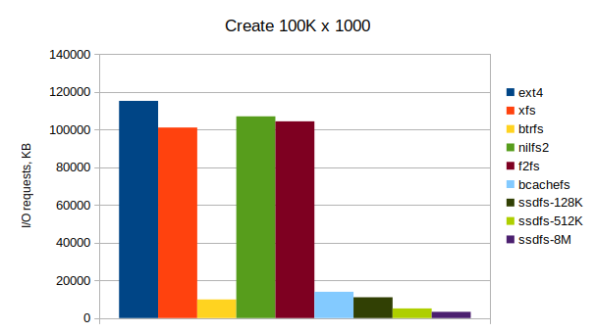
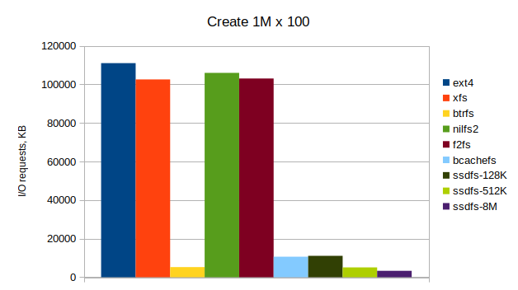
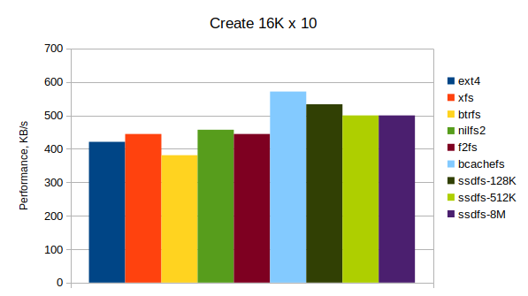
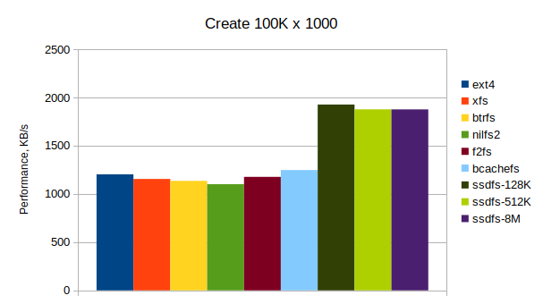
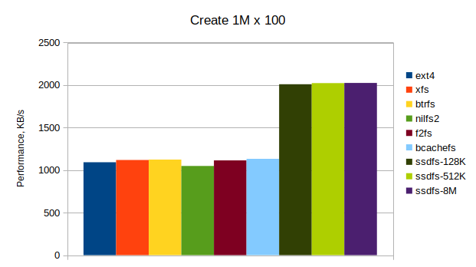
Microbenchmarking: create operation
Duration
The lesser the better
I/O requests
The bigger the better
Performance
SSDFS.ORG

Slide 15
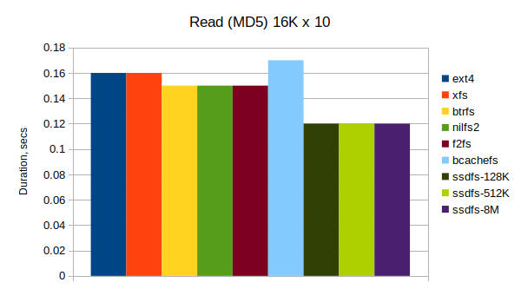
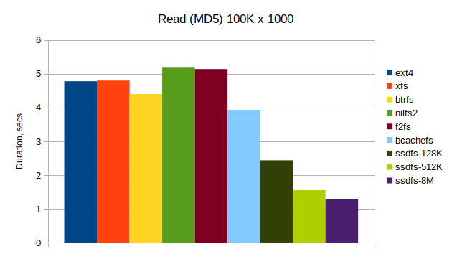
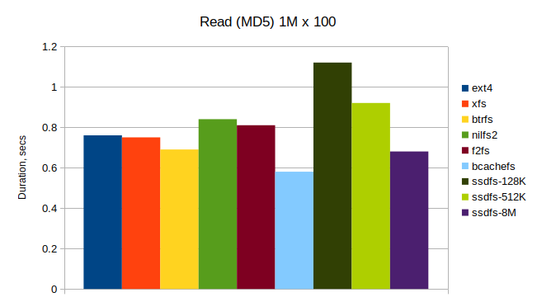
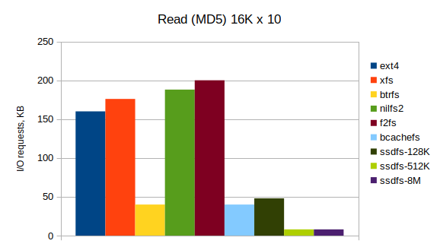
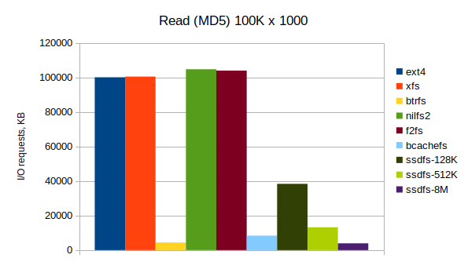
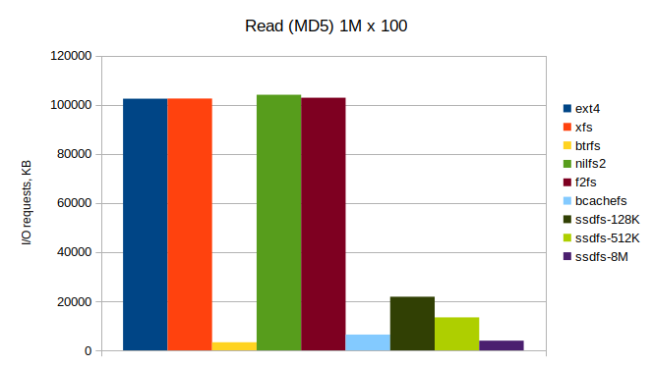
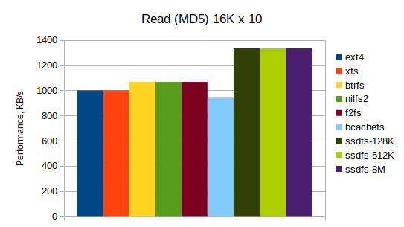
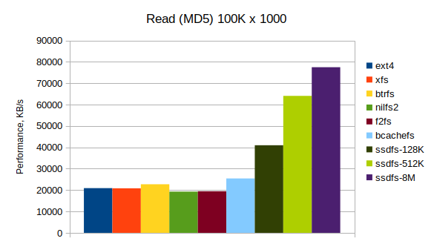
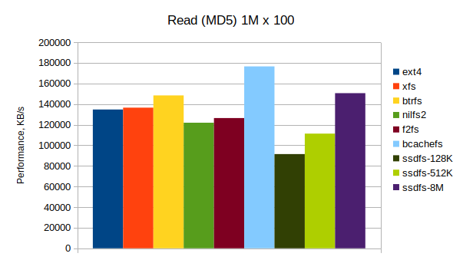
Microbenchmarking: read (MD5) operation
Duration
The lesser the better
I/O requests
The bigger the better
Performance
SSDFS.ORG

Slide 16
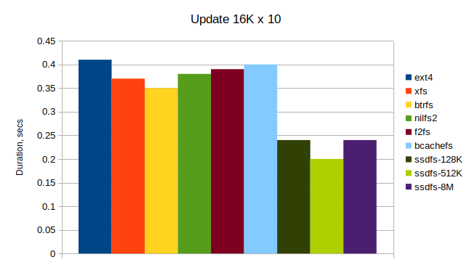
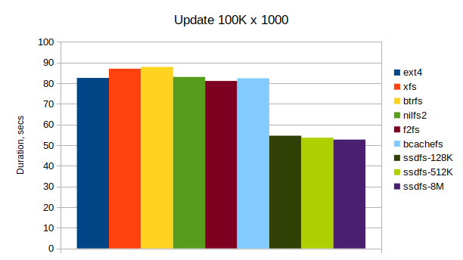
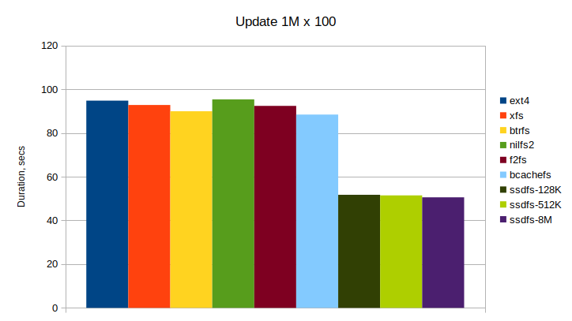
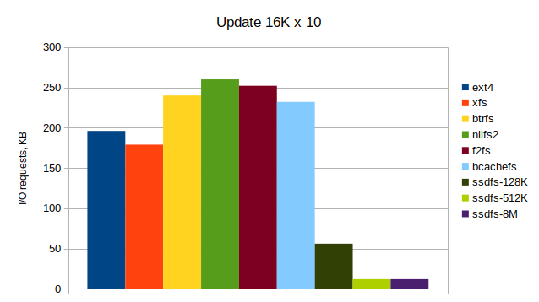
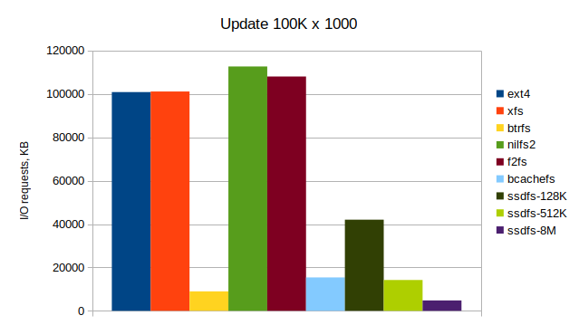
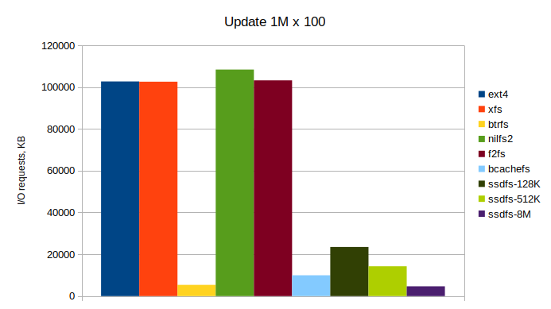
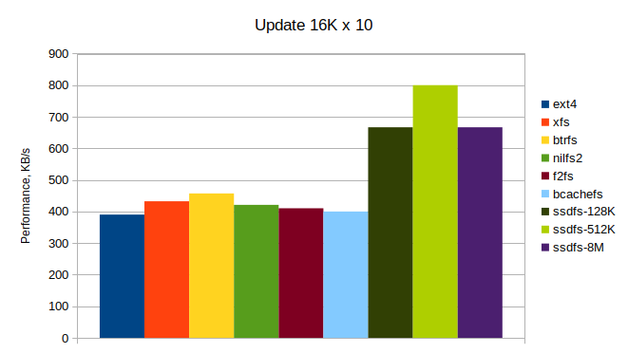
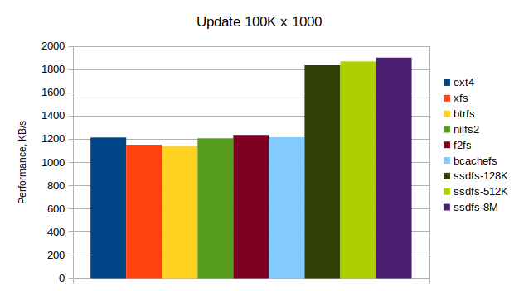
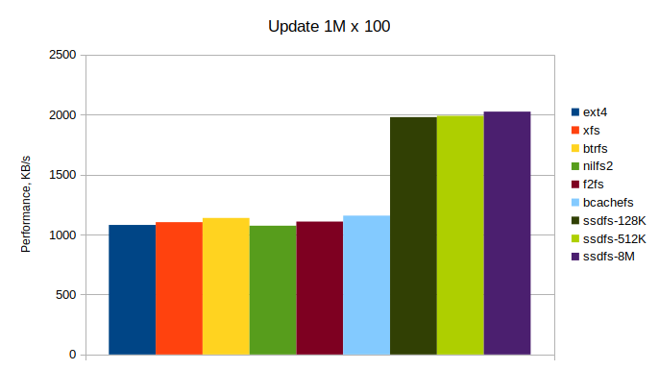
Microbenchmarking: update operation
Duration
The lesser the better
I/O requests
The bigger the better
Performance
SSDFS.ORG

Slide 17
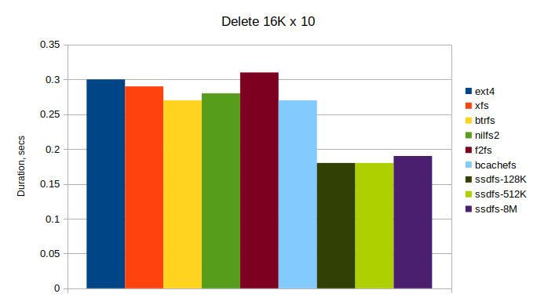
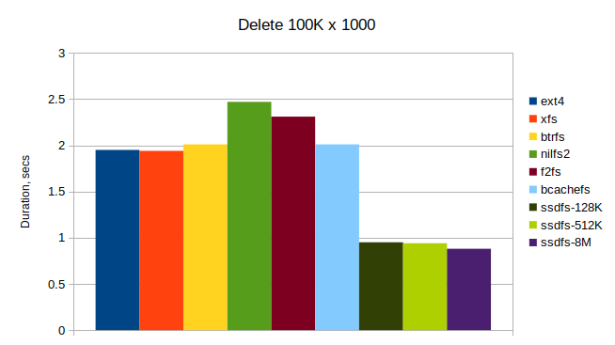
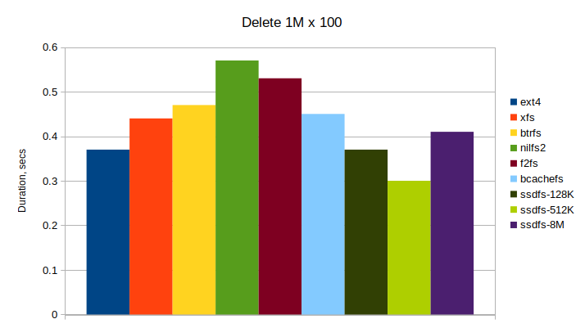
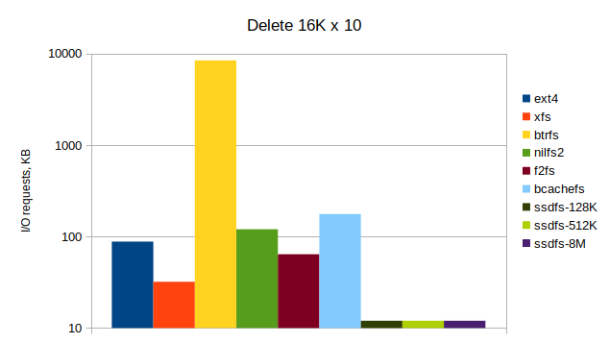
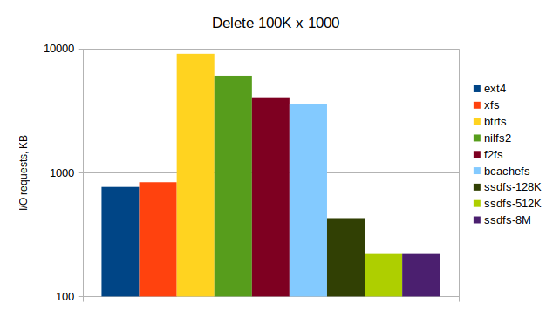
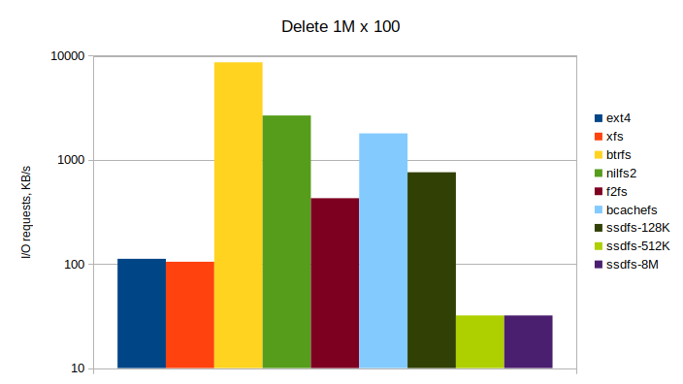
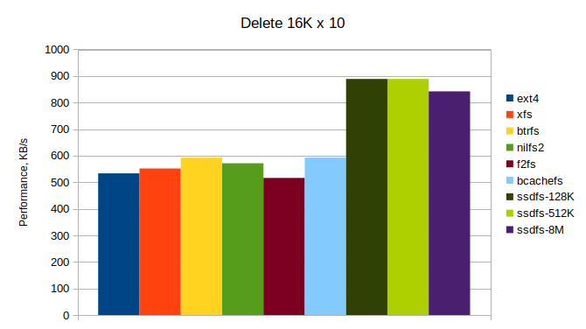
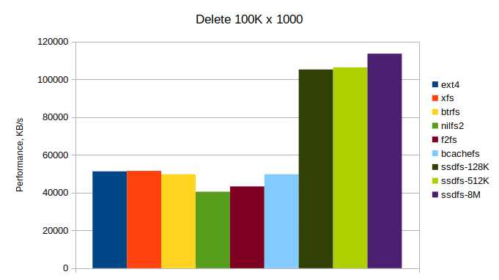
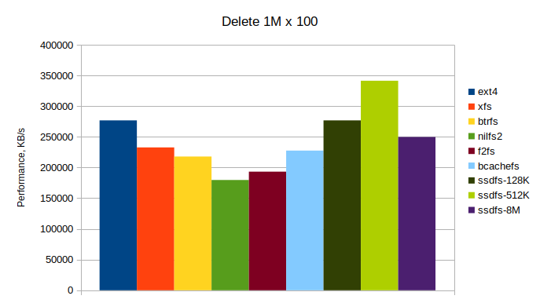
Microbenchmarking: delete operation
Duration
The lesser the better
I/O requests
The bigger the better
Performance
SSDFS.ORG

Slide 18
Microbenchmarking: conclusion
SSDFS is capable to demonstrate a better performance for data with good compression ratio:
create operation:
ext4: 1.2x - 1.8x
xfs: 1.2x - 1.8x
btrfs: 1.3x - 1.8x
nilfs2: 1.1x - 1.9x
f2fs: 1.2x - 1.8x
bcachefs: 0.9x - 1.7x
read operation:
ext4: 1.1x - 3.7x
xfs: 1.1x - 3.7x
btrfs: 1x - 3.4x
nilfs2: 1.2x - 4x
f2fs: 1.2x - 3.9x
bcachefs: 0.8x - 3x
update operation:
ext4: 1.5x - 1.8x
xfs: 1.5x - 1.8x
btrfs: 1.4x - 1.7x
nilfs2: 1.5x - 1.8x
f2fs: 1.5x - 1.8x
bcachefs: 1.5x - 1.7x
delete operation:
ext4: 1.2x - 2.2x
xfs: 1.4x - 2.2x
btrfs: 1.5x - 2.2x
nilfs2: 1.5x - 2.8x
f2fs: 1.7x - 2.6x
bcachefs: 1.5x - 2.2x
The bigger erase block size is the better.
Small erase block size (for example, 128KB, 256KB) could be the reason of bigger amount of metadata in the logs.
SSDFS can be more efficient with small files.
Read operation with big files looks like not very efficient for the case of SSDFS file system.
Create, update, and delete operations look pretty efficient for the most cases.
SSDFS.ORG

Slide 19
Current status, issues, and plans
Stable features:
Mount logic – stable
Mapping table – stable
Segment bitmap – stable
Migration scheme – stable
Inodes tree – stable
Dentries tree – stable
Extents tree – stable
Folio support – stable
8K/16K/32K logical block – stable
Erase block based deduplication - stable
NOT stable features:
Erase block inflation model - not fully stable
ZNS support - not stable
Shared dictionary - not stable
recoverfs - not stable
Xattrs tree – not fully stable
Delta-encoding – not fully stable
Multiple erase blocks in segment – not stable
Under implementation:
Deduplication – not fully implemented
Snapshots – not fully implemented
Fsck – not fully implemented
Erase block inflation model
Shared dictionary
ZNS support
Stabilize
Share a new patchset with open-source community
SSDFS tools: https://github.com/dubeyko/ssdfs-tools.git
SSDFS driver: https://github.com/dubeyko/ssdfs-driver.git
Linux kernel with SSDFS support: https://github.com/dubeyko/linux.git
SSDFS.ORG

Slide 20
Planned new features
FDP support
Delta-encoding similar logical blocks
Online fsck + offline fsck
Scrubbing
Multi-drive support
Erasure coding scheme
File-based deduplication
Snapshot access + management
SSDFS.ORG

Slide 21
THANK YOU QUESTIONS???
SSDFS.ORG

